Slide 1


The Ins and Outs of
Summer Rising 2025

Slide 2



Did any of your students participate in Summer Rising last summer?
If your student participated, what was their experience like?

Slide 3

Today’s Training
What is Summer Rising?
What if there is an issue?
Specialized supports
Application
Transportation
Notes:
-March 10 before 12:30 or after 3:00
-March 12 at 10
-March 13 before 2
-March 17 before 12 or after 3

Slide 4

What is Advocates for Children (AFC)?
4
AFC is an independent agency that protects the rights of all NYC students
Our Services:
  Helpline: 1-866-427-6033 (Mon-Thurs, 10am – 4pm)
  Guides and resources: www.advocatesforchildren.org
  Workshops and trainings
  Free legal services to low-income families
Notes:
Maggie - > p. 20
Founded in 1971 by parents of students with disabilities, our mission has expanded over the years to encompass protecting every child’s right to an education, focusing on students from low-income backgrounds who are struggling in school or experiencing school discrimination of any kind. Have staff with expertise on early childhood education, older youth, immigrant students and English Language Learners, justice-involved students, students experiencing homelessness, and students in charter schools.

Slide 5

Types of Summer Programs
K-8
ESY/D75
Summer Rising: General program
Summer School (PID)
+Summer Rising
+Summer Rising
nyc.gov/summerrising.
Notes:
For NYC public school students, K-8th grade, there are a few summer options
Mandated programming—PID ESY D-75There is no HS Summer Rising program this year.
Current K-8 students only

Slide 6
What is Summer Rising?
Free Summer Program for NYC Residents
Grades K-8: Schools design with a Community Based Organization ("CBO") Partner
In Person, full-day, Mon-Fri 8am-6pm
Includes breakfast, lunch, and a snack
Notes:
Summer Rising is a partnership between New York City Public Schools and the Department of Youth and Community Development (DYCD). Summer Rising is free and available to all NYC students in grades K-8, pending seat availability.
Students in Summer Rising will have access to both academic and enrichment programming over the course of the day, including field trips, arts activities, and outdoor recreation. Programs will planned and operated collaboratively by school principals and community-based organizations (CBOs). The environment will be safe and supportive with staff prepared to respond to children’s social and emotional needs. Breakfast, lunch, and snack will be served.
A typical day for students in grades K–8 will include a mix of academic support, social emotional learning, and enrichment activities. Academics will be provided by licensed teachers in the morning. Enrichment activities (such as art, sports, and play) will be led by CBO staff in the afternoons and on Fridays. CBOs will also facilitate enrichment in the morning, alongside academics, for K-5 programs.
Students with disabilities who may require additional supports to participate in programming, such as a paraprofessional, will receive those supports as needed.

Slide 7
When is Summer Rising?
Grades K-5
July 2 - Aug 15
M-F 8-6 extended day
12-month IEP program (D75)
July 3 – August 13
M-F 8-2:00+ 3-6 ext. day option
ASD Nest/Horizon (12 mos)
Jul 2 – Aug 7
M-TH 8-12 + 12-6 ext. day option
Grades 6-8
July 2 – August 8
M-F 8-6 extended day
12-month IEP program (D1-32) ESY
July 2 – August 12
M-F 8-2:30 + 3-6 ext. day option
*-4th of July
Notes:
12-month programs – hours vary; usually 6.5 hours for D75 and 6 hours for D1-32 around 8-2/2:30
*Students with 12-month IEPs will have the option to participate in DYCD-led extended day enrichment hours (until 6 PM) and programming through August 9, 2024 (6–8 students) and August 16, 2024 (K–5 students).
Families interested in this extended day enrichment should apply via the application portal. If NOT interested, contact the school to arrange for 12month / ASD/ ESY

Slide 8
Important Dates
Apply!
From March 4, 2025 in MySchools
Results and Waitlist
April 24, 2025 in MySchools
Application Closes
March 28, 2025
DEADLINE to accept offer
May 8, 2025 NEW! Must accept or will lose seat
Apply any time before!
Families MUST APPLY between March 4 and March 28!
Notes:
The seats are not issued on a first-come, first-served basis, so families can apply any time until March 28

Slide 9
Summer Rising: Academics-morning
Academics (ELA, math, STEM) licensed teachers provide in the morning, with social-emotional learning.
Students in 12-month programs (D-75/ESY/ASD): IEP mandated specialized instruction and related services, social emotional learning.
CBO staff will support teachers during academic instruction in K-5
PID and those mandated for summer school will automatically be enrolled in the morning program, but must apply to do the enrichment portion of the day
Notes:
will be provided to students by licensed teachers in the morning, along with social-emotional learning.
Monday to Thursday Mornings
Please reach out to accessibleadmissions@schools.nyc.gov(Open external link) and accessibility@schools.nyc.gov(Open external link) for questions around accessible 2025 summer sites.

Slide 10
Summer Rising: Enrichment-afternoon
Extended day services provided by CBO staff
Must enroll before the start of summer
Optional for students with 12-month IEPs/ students who are mandated for summer school
Includes sports, games, arts, dance, SEL, and field trips
All-day enrichment on Fridays
Middle School ESY/D75: No CBO-led programming Fridays
Notes:
Afternoons and Fridays
If a family wants to participate in IEP programming and extended-day enrichment (in other words, programming until 6pm), they should use the application portal. Families in Autism, ESY, and D75 programming will have priority for seats in Summer Rising. Please note that for Middle School Students, there is no CBO led programming on Fridays
2023 guidance: Trips must be accessible for all students. If a student’s accommodations cannot be arranged for a trip consistent with their Accommodation Plan, the trip must be postponed or cancelled until the accommodations are in place.

Slide 11
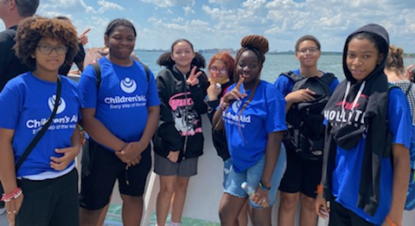
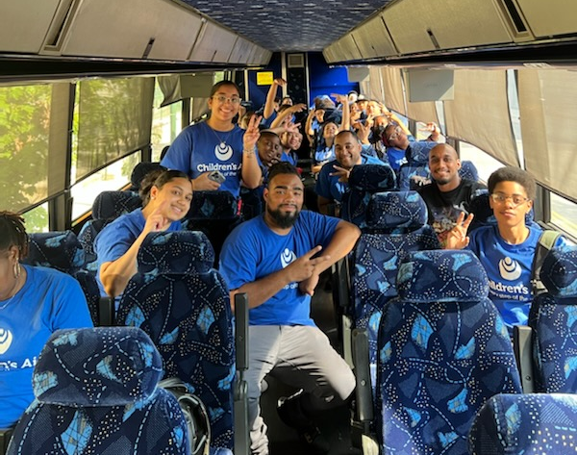
Summer Rising: Trips
Zoos & Aquariums
Movies
Museums
Botanical Gardens
Parks
Cruises
Arcades & Games
Athletics & More
Photos from Children’s Aid’s Summer Rising Program at the Whitney Young Jr Campus
Notes:
Please note that for Middle School Students, there is no CBO led programming on Fridays.

Slide 12
Summer Rising Enrollment
Families must apply between March 4 and March 28
Results and Waitlist in My Schools on April 24
Placement by Priority group, including:
Students mandated for summer school
Students in Temporary Housing and Students in Foster Care
Students with 12-month IEPs
Students who are enrolled in the CBO’s afterschool programs
MUST ACCEPT OFFER BY May 8-or lose seat . Waiting Lists!
Notes:
REMEMBER—mandated summer school and ESY are entitled to those services. Summer Rising is optional.
Will discuss admission priorities later in the rpesentation

Slide 13

Applying for Summer Rising

Slide 14
Summer Rising Application Portal
Apply online at https://www.myschools.nyc.
Log in / Create new account.
Add “all” the programs you are interested in
  NOTE: Students in D75 or ESY programs should only select programs located in their building or school site
Sibling applications for same program
  if all students are within the same "band": K-5 or 6-8
Current fifth graders can apply to K-5, 6-8 and K-8 programs
  Both middle and elementary programs.
Notes:
In past years, demand for Summer Rising has outpaced the available seats. Last summer, about 160,000 students applied for about 115,000 spots, meaning tens of thousands ended up on waitlists.
Thank you for contacting us! This year, 5th graders can pick from K-5, 6-8, and K-8 programs. This means you have options to apply for both middle and elementary school programs.
Important note for siblings - Only children on your dashboard within the same grade band (grades K-5 or grades 6-8) can be added to this application as sibling. This is only applicable if you wish to apply for the same program for both students.

Slide 15
Admissions Priorities for Summer Rising
Affiliated students with PID, or the sibling of such student.
Affiliated students with a 12-month IEP, or sibling.
Students in temporary housing or foster care, or sibling.
Affiliated low-income students, ELLs, and students with disabilities who attend a DYCD program during the school year, or sibling.
Other affiliated students who attend a DYCD program during the school year, or sibling.
Affiliated low-income students, ELLs, and students with disabilities, or sibling.
Affiliated students, or sibling .
Other low-income students, ELLs, students with disabilities, or sibling .
All other students.
Please note: MSs will admit current 6th-8th graders first in the above priority group order. If seats remain, then eligible 5th graders are admitted in priority group order.

Slide 16
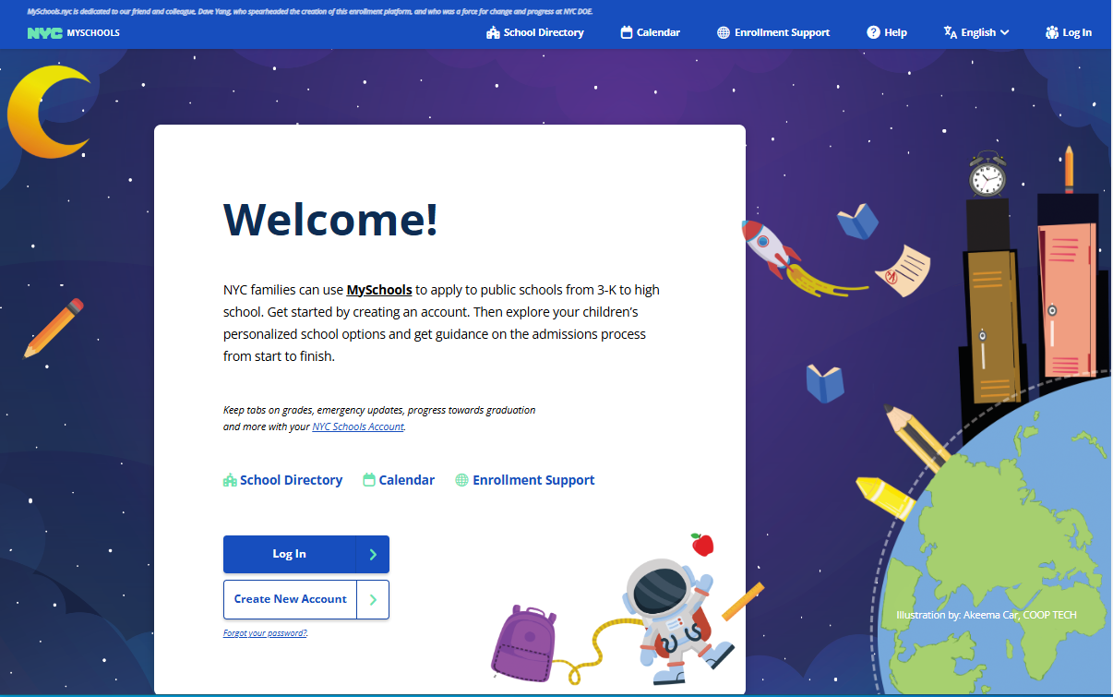
How to Apply
MySchools.nyc
Notes:
Can translate page

Slide 17
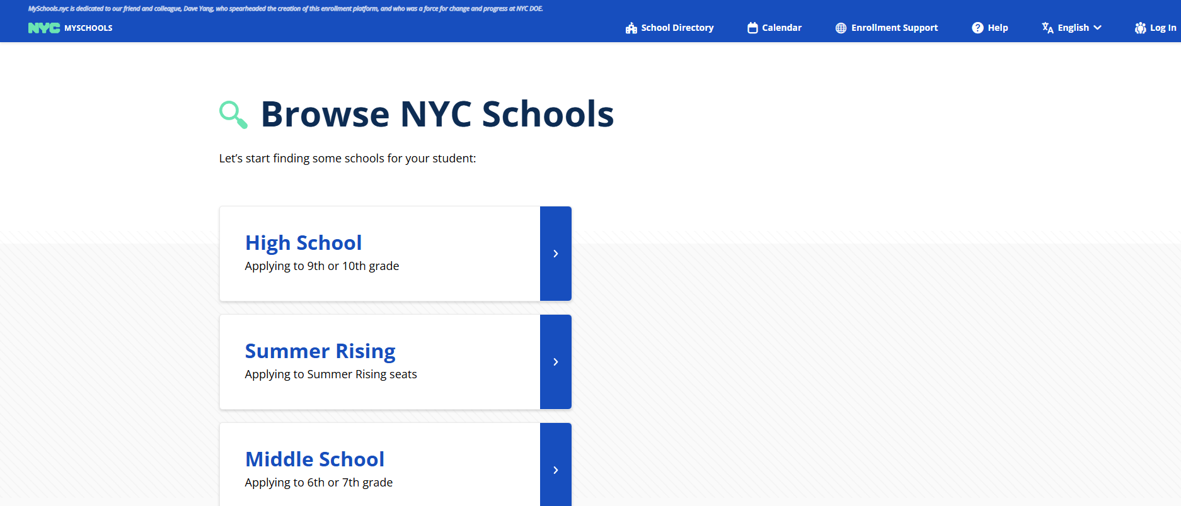
How to Apply

Slide 18
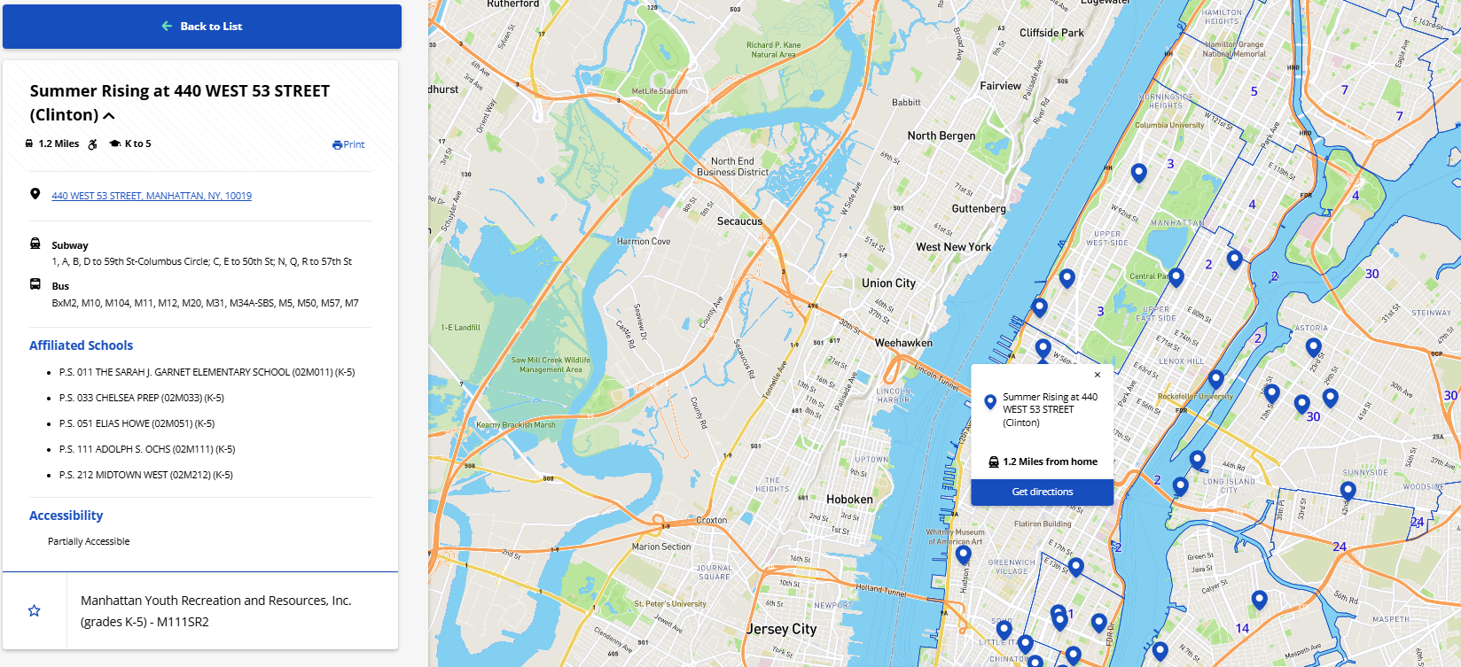
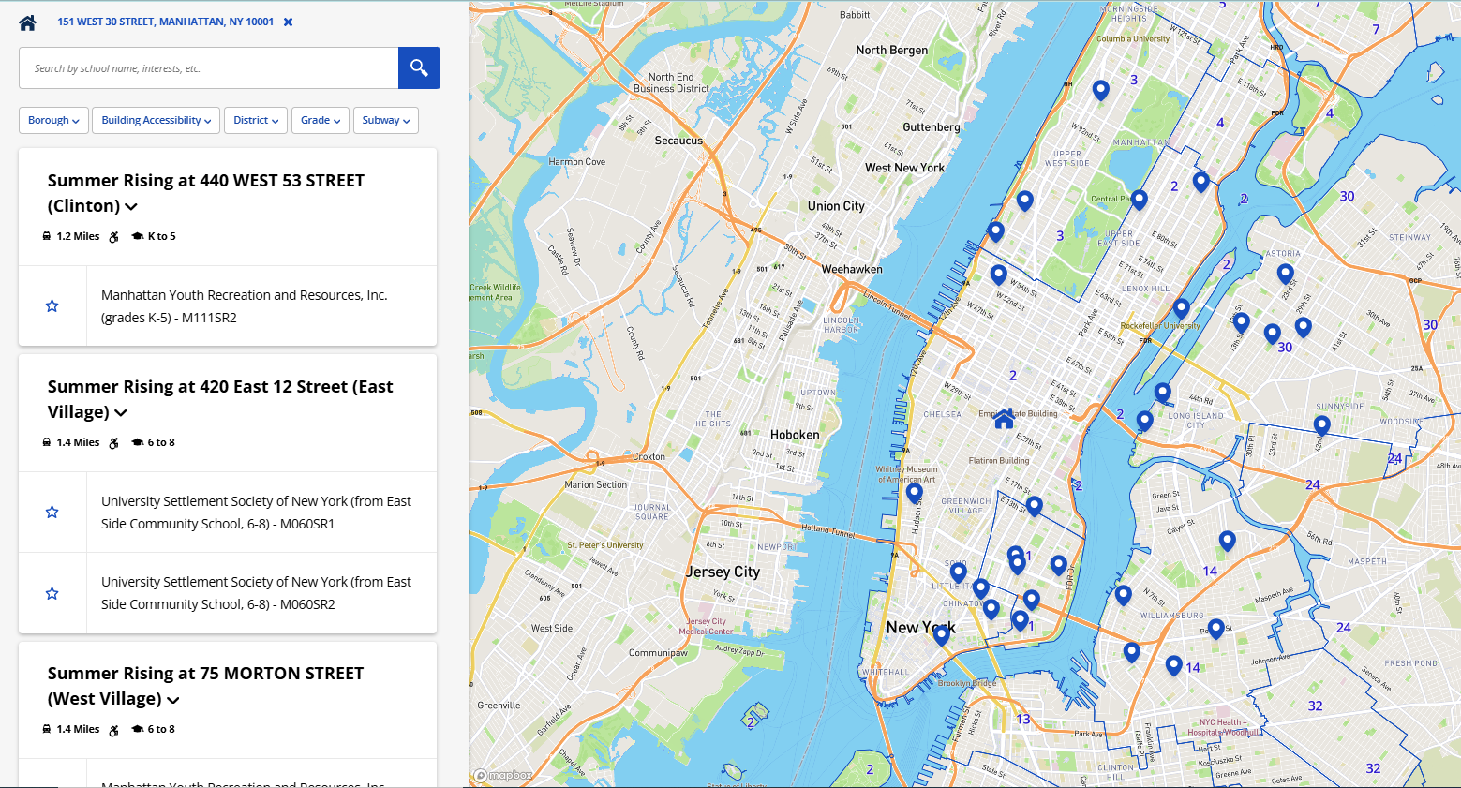

How to Search and Apply

Slide 19
Summer Rising: Next Steps
I got a seat! What's next?
YOU MUST ACCEPT by May 8, 2025 or lose the spot
If a student is mandated for summer school, they will attend Summer Rising at their school or affiliated site, unless told otherwise.
Automatic Waitlist for higher ranked programs than the one offered; can + more waitlists in MySchools after application closes.
Complete CBO forms (i.e., current physical, emergency contacts) before Summer Rising begins.
Notes:
No automatic admission! Must accept program
Families will automatically be added to the waitlist for any program(s) listed higher on their child's
application than the program where they got an offer. Families can add themselves to additional
waitlists in MySchools after the application closes.

Slide 20
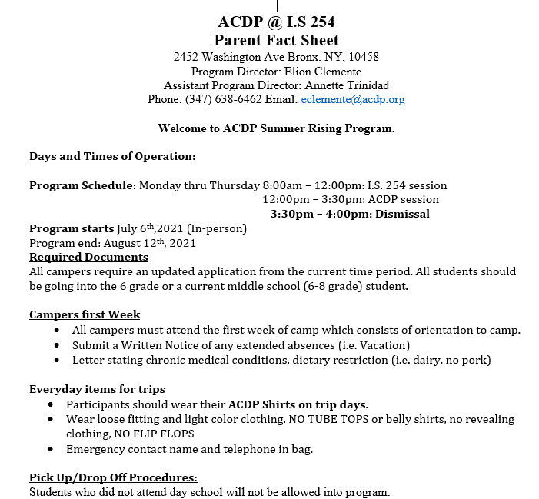
Sample CBO Packet
Notes:
This is just an example of a Summer Rising CBO packet I received for a student last year. This CBO provides information on their program, the program rules that they ask students and parents to assign acknowledging they have reviewed it (mostly about expectations re: attendance and discipline), contact info, and a form for the child’s doctor to complete if they don’t have a current medical on file with the school.

Slide 21

Summer Rising Transportation

Slide 22
Transportation: Who is Eligible?
Students with bussing on their IEP or a 504 accommodation
Must be more than 0.5 miles from Summer Rising site
Students in temporary housing/foster care who qualify for an exception
Students who received stop-to-school busing during the regular school year
Students who got busing during the school year, including:
Students with OMNY cards will continue to use them
Notes:
6PM busing will not be available this summer; however, families of eligible students (Students in Temporary Housing, Students in Foster Care, and students who receive curb-to-school busing and who are signed up for programming until 6PM for Elementary, 6PM for Middle School) will have access to an OMNYCard upon request or pre-paid rideshare, similar to last year.
Students in grades K–6 who are not grade and distance eligible during the school year and whose site is not open for summer will receive busing only from their 10-month site to their Summer Rising site if the two are more than half a mile apart.

Slide 23
Transportation
Busing to/from am and pm
3-6 pm Busing
OMNY Cards
STH/FC/IEP Home/curb
DOE will not bus after 3 pm
Includes ride from work/home to Summer Rising site for the parent
Pre-paid Rideshare:
Students must be accompanied by an adult
Does not include extended day
Summer Distance Eligible-from home school
Notes:
Check status on your NYCSA account—voucher codes
Qualifying students: Students with special education transportation, students in foster care/temporary housing or any other approved exception.
6PM busing will not be available this summer; however, families of eligible students (Students in Temporary Housing, Students in Foster Care, and students who receive curb-to-school busing and who are signed up for programming until 6PM for Elementary, 6PM for Middle School) will have access to an OMNYCard upon request or pre-paid rideshare, similar to last year.
Limosys directly at 212.426.8000 or email Doe@limosys.com. If families need access to the voucher code for Limosys , they should log into their NYC Schools Account (NYCSA), under the Transportation screen’s Vehicle Modifications field it will be listed as the Eligibility Code. If families do not have a NYC Schools Account (NYCSA), the CBO should escalate to the NYCPS staff member with access to Student Profile, e.g. the Transportation Coordinator, the PIC/AP Site Supervisor, or another designee, who can look up this eligibility code after confirming the adult is authorized to pick up the child.

Slide 24
Busing: How do you request it?
Students who get busing during the school year will automatically be routed.
What happens if a child moves?
Make sure the school updates the child’s address
Students must enroll with the correct address by May 13th to be guaranteed a bus route by July 2nd
Can families get rideshare if the student moves after May 13th or over the summer, until busing is ready?
Students can get rideshare for extended day (6 pm) pick-up.
if no IEP-mandated busing, complete Exceptions Request ASAP
Notes:
We are waiting to hear back from the DOE to see if they will provide rideshare to students who get busing and move after May 19th/over the summer.

Slide 25

Specialized Summer Rising Supports

Slide 26
Students with 10-month IEPs
Summer Rising Accommodation Plan
Need other supports? Request in writing ASAP!
Developed by the home school
Provided to the parent and Summer Rising site
Nurses/Paraprofessionals
1:1 nurses/health paras provided for the full day
Behavior support paras during academic portion only + "as need" support during enrichment.
Notes:
https://www.myschools.nyc/en/help/summer-rising/accommodations/

Slide 27
Students with 12-month IEPs
D-75/ ESY/Autism Programs choices:
Remember: Busing only until 3pm, rideshare after.
Only IEP Program
IEP Program + CBO Enrichment until 6pm
IEP + Enrichment?
Apply using MySchools
Priority Admission
Rank program at am location to stay at same site
If it is not an option, rank other sites and DOE "will aim" to offer transportation.
IEP only (No afternoon program)?
Contact child's schools
Notes:
https://www.myschools.nyc/en/help/summer-rising/accommodations/

Slide 28
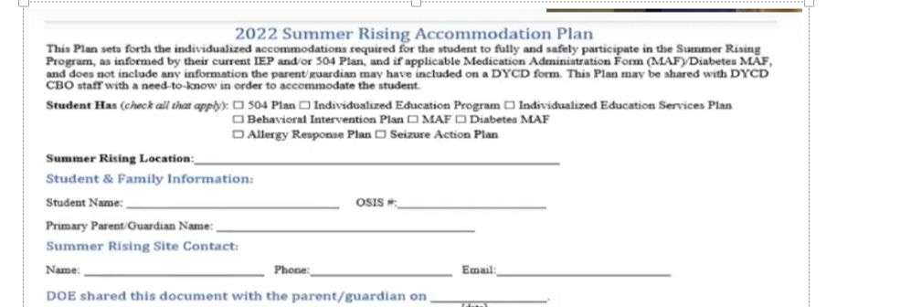
Individual Summer Rising Accom. Plan
Notes:
Blank Summer Rising Accommodation Plan from last school year. The DOE hasn’t released this year’s form yet, but I’ve been told it will look very similar.

Slide 29
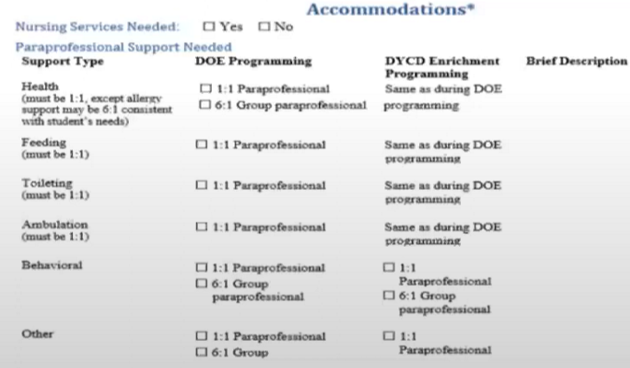
Accommodation Plan - continued
Notes:
The student’s home school will prepare a Summer Rising Accommodation Plan that will be given to the student’s parent and the student’s Summer Rising site before Summer Rising begins

Slide 30

Summer Rising: Supports for ELLs
General supports
Morning language/literacy instruction
Small group or 1:1 support from ENL teacher
Notes:
Multilingual learners/English language learners (MLs/ELLs) in grades K-8 participating in Summer Rising will engage in academically rigorous, culturally responsive, and student-centered options in the morning and participate in afternoon enrichment sessions facilitated by trusted community-based organizations.
Additionally, MLs/ELLs will receive instruction targeting language and literacy development and access to grade-level content through an integrated English as a New Language (ENL) co-teaching and/or standalone ENL instructional model over the summer. This may also include small-group instruction or one-to-one support for MLs/ELLs.

Slide 31
Charter Schools
Can apply to Summer Rising or Summer Boost (March 14 Deadline)
Check with your charter school to see if they will be participating.
Can only enroll in one program.
Students whose charter school doesn’t offer Summer Boost, or who prefer Summer Rising, can apply to any Summer Rising site.
Notes:
https://www.summerboost.org/
K-8th grades in 24-25 program
Just remember that students will get priority at the school they attend during the regular school year (or at the site affiliated with their school), so good idea to apply to multiple programs to increase the student’s chance of getting in.

Slide 32

What if there are problems with Summer Rising?

Slide 33
Problem Solving:
Start with the school
Parent Coordinator
summer@schools.nyc.gov
Contact AFC
Principal
CBO Site Director
Go up the chain at DOE
Superintendent’s Office
Call us!
Email us: Info@afcnyc.org
Notes:
Additional contacts – for issues related to students with IEPs, can reach out to Ariana Jaffe, who presented at the Ed Forum last week. Also Daniella Inga re: transportation, DOE foster care team for issues specific to students in foster care.

Slide 34

Other Summer Resources
Free summer meals are also available to children under18 not attending Summer Rising
Notes:
Free, no need to sign up, no id needed, locations TBD. This is a program run by the NYC Parks Department. They haven’t publicized their list of summer meal locations yet, but should be up on their website in the next six weeks or so.
Breakfast and lunch are available for all children ages 18 and younger and all people with disabilities, regardless of age, who participate in special education programs.
** No identification or application is required **
Meals are free and provided by the U.S. Department of Agriculture (USDA) through the Office of Food & Nutrition Services, a part of the New York City Department of Education.
Locations & Hours
For the full list of all Free Summer Meals locations (including at parks and pools) and their breakfast and lunch schedule, please visit DOE's Summer Meals website.

Slide 35

Other Summer Resources
InsideSchools free/low-cost summer programs: https://insideschools.org/resources/free-programs
Summer Camp Resources: https://drive.google.com/drive/folders/10WBU5d3NW8_2tUP7mQoiVj5ctps1Vrmy?usp=share_link
Notes:
The second link takes you to Project Achieve’s Google Drive, where we have a folder of summer camp resources that may be helpful. You can also access the folder from the General Education page of our virtual binder.

Slide 36
Reminders!
Summer Rising is optional and by application.
Every current K-8 NYC Student can apply!
  But seats are not guaranteed for all
Mandated for Summer (D-75/PID/ESY): apply to your school's Summer Rising
  Or closest "affiliated" site if none at the home school.
  Not interested in Summer Rising: Contact school directly.
Charter School: Summer Boost or Summer Rising
Not Mandated for Summer Services: Apply to sites you are interested in!
  IEP? Individualized Accommodation Plan
  Remember admission priorities, including affiliated sites!

Slide 37


Call us with questions!
Helpline: 866-427-6033 (toll free)
Monday-Thursday, 10am-4pm
info@advocatesforchildren.org
Notes:
Thank you for coming! Please complete our evaluation before you go.
Remind audience that this process is complicated, with lots of information, won’t be able to answer all questions…
So they should call us with questions!!
Use our guides!
Go to more workshops!

