Slide 1
Navigating School Discipline
in new York city
Presented by:
Ross Baker
School Justice Project
Notes:
Charter Schools can design their own discipline code, but must abide by State Regs
Hi all, Welcome to Navigating School Discipline in New York City. My name is Rohini Singh, and I will be your presenter today. We will wait a few minutes to get started while folks trickle in… just a few housekeeping notes. First, we will be sending out a copy of this PPT after the presentation on Monday and so please know that you will get a copy of all of these slides.
During the presentation I will pause a few times for questions, the chat is disabled right now but you can ask questions through the Q&A feature on your Zoom toolbar. I am joined today by Lilliana from AFC, who will be monitoring the Q&A and will either answer or read out questions that come up when I pause for questions.
LAUNCH Polls

Slide 2
Today’s Training
Introduction
Types of Suspensions and Parent’s Rights
Legal Protections for Students with Disabilities
Key Takeaways

Slide 3
Suspension and Discipline Work
Help young people who are facing:
Juvenile and/or criminal justice system involvement
School suspension
Exclusion from school due to their behavior
Bullying behavior
Advocate for alternatives to discipline and for behavior supports and services so students remain in school
Participate in city and state-wide coalitions to reform school discipline policies and procedures, and advocate for investments in supports for students
Notes:
Rohini
We also specialize in helping families navigate the suspensions and school discipline in NYC schools.
At AFC, we help young people who are facing
Juvenile and/or criminal justice system involvement
School suspension
Exclusion from school due to their behavior
Bullying or accused of bullying
We advocate for alternatives to discipline and for behavior supports and services so students remain in school
We participate in city and state-wide coalitions to reform school discipline policies and procedures, and advocate for investments in supports for students

Slide 4
Students who are suspended are more likely to:
Miss class
Be held back a grade
Be suspended again
Drop out
Get arrested
Notes:
Change to graphic (down steps/arrow)
In 1 school year, suspensions led to children missing 316,105 days of school, the equivalent of 1,756 school years. With that amount of time, a student could attend college 439 times.
Source: Council of State Governments Justice Center, Breaking Schools’ Rules: A Statewide Study of How School Discipline Relates to Students’ Success and Juvenile Justice Involvement (2011); Losen, D.J., Gillespie, J., Opportunities Suspended: The Disparate Impact of Disciplinary Exclusion from School, The Center for Civil Rights Remedies at The Civil Rights Project (2012). Losen, D., Hodson, C., Keith II, M.A., Morrison, K., Belway, S., Are We Closing the School Discipline Gap?, The Center for Civil Rights Remedies (2015).
Additionally, without appropriate supports and interventions, students may be improperly told to stay home, placed on a truncated school schedule, sent to a hospital emergency room for behavior that could be managed by the school, otherwise excluded and, in essence, pushed out of school.

Slide 5
Suspension Data
In the 2021-2022 School Year...
DOE issued over 25,000 suspensions and over 6,600 classroom removals
40% of all suspensions went to students with disabilities, who only comprise 21% of DOE enrollment
Black students received over half of all superintendent's suspensions despite making up only 21% of DOE enrollment
Source: DOE data reported pursuant to the NYC Student Safety Act.
Notes:
Principal’s suspensions = in-school, shorter (1-5 school days)
Superintendent’s suspensions = out-of-school, lasting 6-20 school days (can be longer in limited situations)
Suspensions weren’t always this high; started increasing in the early 2000s
Drop in 2019-20 was largely because schools were closed for three months—not as good as it looks
Re: disproportionality
Black students are 22% of the population, but receive 43% of suspensions
SWDs are 20% of the population, but receive 40% of suspensions
For 2021-2022
During the 2021–22 school year:
DOE issued over 25,000 suspensions and reported an additional 6,600 classroom removals.
40% of all suspensions went to students with disabilities, who were 21% of the population.
Black students received over half of superintendent’s suspensions (suspensions lasting 6–180days), despite making up only 21% of DOE enrollment.
With each exclusion from school, students lose days, weeks, or even months of instructional time and may disengage from school entirely, alienated from the place that should be a haven for learning.
Suspensions continued to rise in the 2022-2023 school year. They are up 27% compared to last year, and 6% from the year just before the pandemic (July-December 2019)

Slide 6
Your child is acting out in school. True or False:
The school can call you to come pick up your child early.
Your child needs a doctor’s approval to come back.
After a suspension, you have to meet with the principal
before your child can come back to school
The principal can call EMS if they think your child is a
danger to themselves and others
A student can be suspended for a year
Notes:
Launch Intro Quiz (Slide 7)
Principal MUST first try to safely de-escalate with strategies and interventions (Building Response team, Crisis intervention team, School Based Health and Mental Health clinics) BUT if behavior poses an imminent/substantial risk of serious injury and can’t handle it in the school, call 911.
http://schools.nyc.gov/Offices/OSYD/de-escalation.htm

Slide 7
Types of Suspensions and Removals in NYC
Teacher’s removal
Principal’s suspension Superintendent’s Suspension
Notes:
RB
All the information in this section is explained in great detail in our recently updated Suspension Guide

Slide 8
The NYC Discipline Code
Notes:
Basis for all suspensions in NYC district schools. Available on DOE website and updated annually. Different versions for K-5 and 6-12. Includes DOE mission statement on school climate, student bill of rights and responsibilities. Was substantially modified in Sept. 2019 to include greater focus on behavioral interventions and supports.
Beginning on page 13 of the Code, you will see information on progressive discipline as well as a glossary of positive behavioral supports and interventions and a glossary of restorative practices that schools are expected to use INSTEAD of or in addition to punishment. If you are working with a student who is experiencing behavioral challenges, make sure the school is using these techniques and not just resorting to suspensions or classroom removals. This is required by the Discipline Code. If schools are not following these steps, let us know. Can put you in touch with the Borough School Climate Manager or OSYD for support.
After this, there is a section on bullying, supports for students with disabilities, then beginning on page 25, information on disciplinary responses. Lists the factors a school should consider when determining discipline for a student, such as the student’s age and maturity level, the circumstances surrounding the incident – was it self-defense? Was the student triggered in some way? Was the student being bullied? as well as the student’s family situation and whether they have an IEP. These are all things you can use at a suspension hearing or prior to an in-school suspension to argue for a shorter suspension or for a punishment that does not involve time outside of class.
Finally, on page 32 you’ll start to see the different infractions students can be accused of, and the possible guidance interventions and disciplinary responses. These will differ by age/grade, so make sure you are looking at the correct code!

Slide 9
Notes:
Sample page of discipline Code, broken up on two parts infractions

Slide 10
Notes:
Sample page of discipline code supports and interventions and disciplinary responses

Slide 11
Types of Suspensions
Teacher Removal
Principal’s Suspension
Up to 5 days
Principal holds conference
Superintendent’s Suspension
From 6 – 20 days**
Requires formal hearing
Up to 4 days
Parent can ask for meeting
Phone call
Written notice
Written notice
**20+ days: for some Level 5 infractions ONLY
No other removals are allowed!
Notes:
Teacher Removals: “…
Behavior that …
substantially disrupts the education process
substantially interferes with a teacher’s authority over the class
Every effort should be made to address substantially disruptive classroom behavior using in-class disciplinary responses (i.e., meeting, parent/teacher conference, afterschool/lunch detention) along with appropriate supports and interventions prior to implementing a teacher removal.”
Teacher can only remove the student from their own class. If the parent asks for a meeting, it must be held within 2 days. Can be a good idea to request one, especially if there are supports the school can put in place that could help the student. You might ask the school to implement restorative practices, such as peer mediation or conflict resolution, or you could request a behavior contract, at-risk counseling, etc. If the student has longer-standing behavioral challenges, may need a special education referral, FBA/BIP, etc.
Suspensions:
Behavior that…
presents a clear and present danger of physical injury
prevents the orderly operation of classes or other school activities
endangers the safety, morals, health or welfare of others
Principal’s suspensions:
For those of you who also work with younger students, know that principal and superintendent’s suspension should be very rare. For students in grades K-2, NOT allowed except in very limited circumstances where the student’s behavior is repeatedly violent or could cause serious harm.
For students in grades K-3, principals also must get approval from the Office of Safety and Youth Development at DOE Central.
Superintendent’s suspensions:
Not allowed at all for students in kindergarten to 2nd grade, unless they bring firearm or explosive to school (required by federal law).
Suspensions longer than 20 days are ONLY allowed for certain Level 5 infractions - when required by law or for “seriously dangerous or violent behavior.” Must be approved by the Chancellor, his designee, or the Community Superintendent.

Slide 12
Other Discipline
Can only be expelled if over 17 and no IEP
Cannot use corporal punishment
Cannot transfer student without permission
Notes:
OSI
How to report?

Slide 13
Principal’s Suspension: Notice to Parent
WRITTEN NOTICE IS REQUIRED
(in parent’s language)
By personal delivery (within 24 hours)
Statement of student’s rights
Reasons for suspension
(including date, time, place of incident)
Period of removal and alternative instruction
Date, time, and place of suspension conference
Ch. Reg. A-443(III)(B)(2)
Notes:
Personal Delivery: By fax, email, mail, or in person

Slide 14
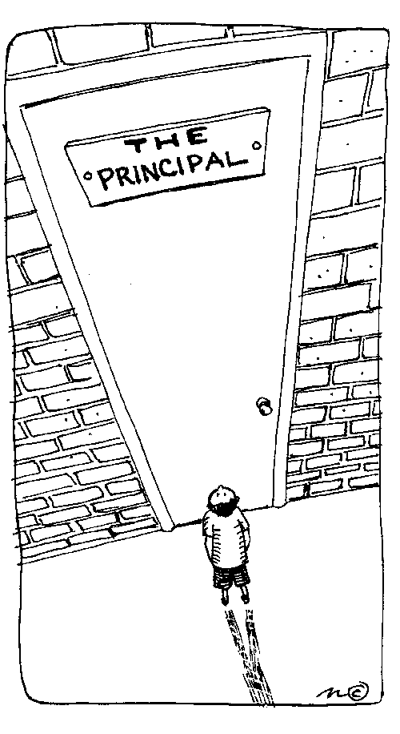
Principal’s Suspension Conference
Student must stay in class until suspension conference
Except if “threat of danger”
Principal must attend conference
Decide if suspension is justified
Parent’s rights
Present student’s version and question witnesses
Right to interpreter
Discuss plan to address behavior
Notes:
Exceptions: if immediate suspension, notice must include info about alternative instruction
If suspension not warranted → suspension records expunged
We have been tracking issues with principal’s suspensions where the notice, conference, and/or education during suspension doesn’t comport with the legal requirements. We have been doing lots of appeals and have won nearly all of them. Let us know if you see any improper notices or other principal’s suspension issues.

Slide 15
Superintendent’s Suspension: Notice
Parent must get written notice within 24 hours, including:
Reasons for suspension
Alternative school location
Details about hearing
(scheduled within 5 school days)
Witness List
Parent’s rights and places to call for help
School must get approval and call parent immediately
Notes:
Reasons for suspension: date, time and place of incident
Witness list is non-binding list of people who may testify for the school
- Students are allowed to stay in school before the hearing (except where they pose a continuing danger to persons or property or an ongoing threat of disruption to the academic process). Examples of infractions where students may not be removed: cheating, stealing, possession of drugs, etc.
- Students with disabilities cannot be removed before suspension hearing (except when accused of certain infractions, mostly involving threats of harm)

Slide 16
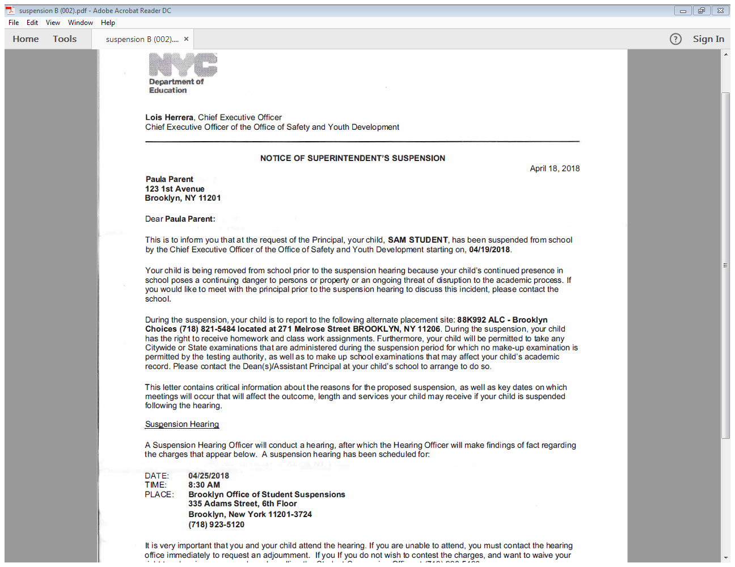
Notes:
Superintendent's suspension notice.
Many pages of legalese – this is different from the suspension packet!

Slide 17
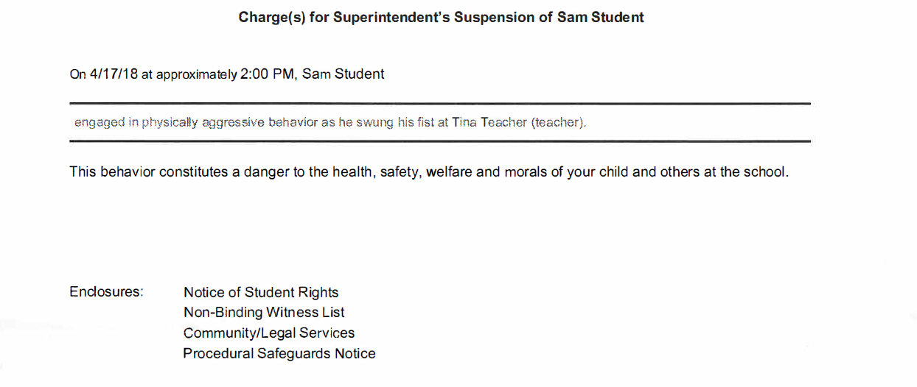
Notes:
Point out that these are two separate pages – usually 2 and 3 or 3 and 4 of suspension notice.

Slide 18
Ask the school for the suspension packet!
Occurrence Report
Witness Statements, including from student
Records Cover Sheet
Evidence Voucher
Injury Reports
Video
Other School Records
The school must give it to you before the hearing.
Notes:
The suspension packet is different from the suspension notice!
Records cover sheet – includes the length of suspension the school is requesting
Records includes report cards, attendance, disciplinary history, IEP
Evidence Voucher: picture of knife
The parent is entitled to the full packet on request. Some schools tell parents they need to wait until right before the hearing. This is not true! If there are issues, you can contact the Borough Suspension Office and they will tell the school that they must turn over the packet.
Check the packet to make sure it has the occurrence report and records cover sheet-superintendent’s suspension, in addition to the witness statements. These documents are part of the packet, but may not be turned over to the parent if not specifically requested.
Video – May be very difficult to get if the school is not using

Slide 19
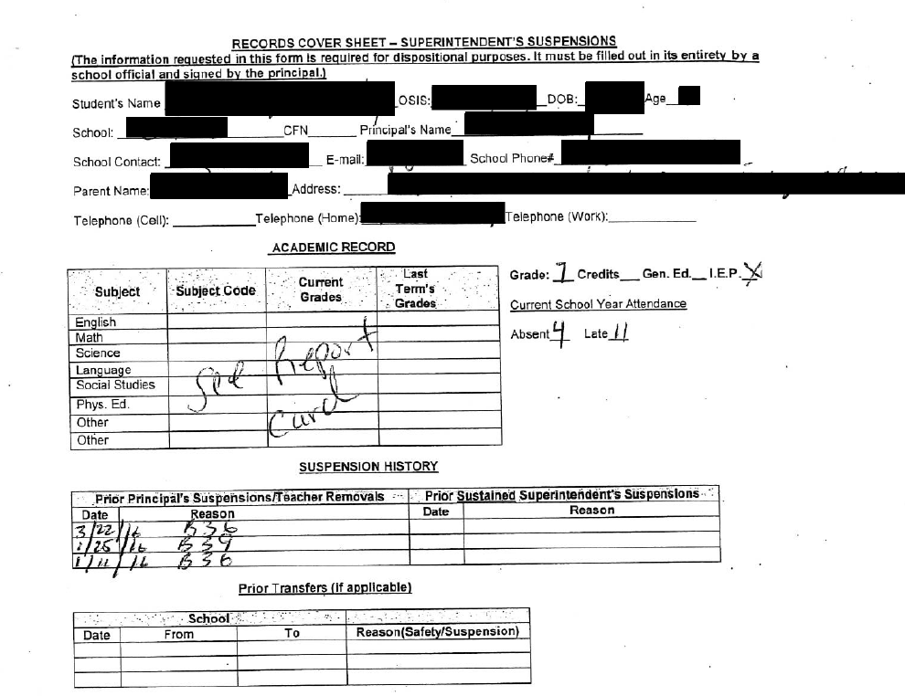
Notes:
Sample cover sheet; long paper (8.5 x 14), so we split it into two slides.
Student info at the top that we blacked out. Includes academic summary, summary of prior suspension history (make sure this is accurate since it will go into the record).

Slide 20
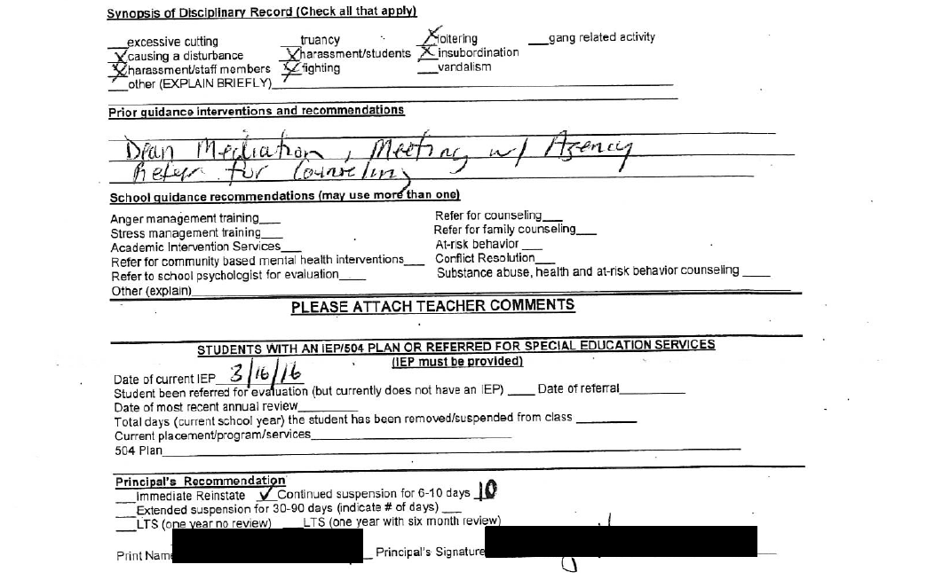
Notes:
At the bottom of the page, they list guidance interventions that have been offered – again, make sure this is accurate. If the school hasn’t offered any, that is a warning sign and something to potentially bring up at the hearing.
At the very bottom of the page, the records cover sheet says what the school will be recommending at hearing. It is immediate reinstatement? 6-10 day suspension? 20 days, or longer? This is crucial when deciding your advocacy strategy. If the school doesn’t give you the records cover sheet or it’s not ready when you get the packet, just ask the Dean/guidance counselor what they are thinking. You may be able to negotiate something with a no-contest plea.

Slide 21
Notes:
Sample witness statement. [Note: we redacted the student’s name so we could use it at this training – the witness statement actually did indicate which student threw the milk. Otherwise, it wouldn’t be very helpful!]

Slide 22
Notes:
Sample Occurrence Report

Slide 23
Superintendent’s Suspension Hearing: Options
Adjournment for Good Cause
Plead No Contest
Proceed with Hearing
Notes:
Adjournments:
Either the parent or the school may request an adjournment to gather evidence, contact witnesses, or to request a hearing date that is more convenient for the parent.
When the parent requests an adjournment, the student stays at the suspension school. If the school requests the adjournment, the student is reinstated to his regular school.
Plead No Contest
Waives right to hearing
Student doesn’t admit to or deny charges
Charges are sustained
No evidence about the incident goes into the record
Parent has 3 school days after learning the decision to withdraw a no contest plea
Withdraw no contest plea – whichever is later
3 days of hearing about the decision (via phone or email)
7 days of receiving written decision (by mail)
Or Within 7 days to withdrawn no contest plea of the date of the letter confirming plea
When might it be a good time to plead no contest?
The evidence against the student is very strong
The evidence against the student is particularly bad – i.e., their was a fight and the other student or a teacher was badly injured, and you don’t want evidence of the injuries to go into the record (on the other hand, if the victim wasn’t hurt in anyway, you might want to go forward so that the hearing officer knows that)
You can work out a deal with the school to amend the charges or request a shorter suspension if you agree to plead no contest

Slide 24
Superintendent’s Suspension: Post-Hearing Decision
Hearing officer makes recommendation based on
testimony and all documents in evidence
Within 2 days of hearing
parent must receive notification:
Within 5 days of hearing
hearing office must mail a full report of Findings and Disposition to the parent
whether charges are dismissed or sustained,
if charge sustained, where student is assigned to attend school,
how suspension will be reflected in student’s records, including when expunged
Student remains at alternative education site pending decision, unless the parties agree otherwise
Ch. Reg. A-443(III)(B)(3)(u)

Slide 25
If The Charges Are Sustained…
Superintendent may:
For most infractions:
Immediately reinstate student to school
Continue the suspension for 6-10, 11-15, or 16-20 school days
For very serious behavior, only by DOE main office approval
Continue the suspension for more than 20 schools days up to 1 year (automatic review for 40 or more school days
Expulsion:
only possible for students without IDEA protections who turned 17 before the school year
Recommend services
Grant or deny school transfer, if parent requests
Ch. Reg. A-443(III)(B)(3)(u)
Notes:
If
Suspension for 21-39 school days
Suspension for 40-180 school days
Automatic review at 30 school days and a review every 15 school days after that
One-year suspension Automatic review for early reinstatement at 60 school days and a review every 30 school days after that

Slide 26
Appeals
Must be in writing, and state grounds for appeal and relief requested
Extensions for good cause only
1st Level: Chancellor/Office of Legal Services
Timing:
Must file within 20 school days of date of decision or 10 school days from receipt of tape recording or hearing transcript, whichever is later
2nd Level: NYS Education Commissioner
Timing:
Must initiate within 30 days of decision, unless delay is excused by Commissioner for good cause shown in the petition
N.Y. Educ. Law § 310; Ch. Reg. A-443(IV)
Notes:
First Level of Appeal to Chancellor
Must be filed within 20 school days of date of the decision or 10 school days from receipt of tape recording or hearing transcript, whichever is later (extension may be granted for good cause)
Must be filed simultaneously with Office of Legal Services
Chancellor must issue written decision within 15 working days following completed filing of appeal record
If decision that suspension not justified, student must be returned to the school from which he/she was suspended, unless otherwise agreed to by parent, and all records pertaining to suspension and proceedings related to it expunged from the student's record
Second Level of Appeal to NYSED Commissioner
Must be initiated within 30 days of decision, unless delay is excused by Commissioner for good cause shown in the petition.
Parts 275, 276, and 277 of the Commissioner’s Regulations
http://www.counsel.nysed.gov/appeals/ed-law-regs
If you are thinking of appealing a case, request a transcript!

Slide 27
Questions?
Notes:
RB

Slide 28
Alternative Instruction
Homework
Classwork
Exams
Full time instruction*
At student’s school, a different school,
or an Alternative Learning Center

Slide 29
Alternative Instruction
During principal’s suspension or while waiting for suspension hearing:
K-8: full-time instruction
High School: at least 2 hours/day
After suspension hearing
All students who continue to be suspended have right to full-time instruction.
Ch. Reg. A-443(III)(B)(1)
Notes:
Sometimes schools send students home--this should not happen. If it does happen, you can help the parent contact the principal or assistant principal to let them know they are not allowed to do this and request an immediate meeting, if necessary. If the administrators resist, you can help the parent contact the Superintendent’s office – the phone number is on the school website.

Slide 30
Protections For Students With Disabilities
FBA & BIP
Suspension plan
Expedited evaluations
Manifestation Determination Review (MDR)
Notes:
Suspensions are disproportionately imposed on students with disabilities. This is true even though the law gives extra protections to students with disabilities who are being disciplined in school. These rights are included in federal education law and so apply to all students in public schools across NYS as well as charter schools.
MDR – meeting where team decides if the student’s behavior was because of their disability.
Suspension plan – explains services/accommodations students will get while serving a long-term suspension.
We will discuss each of these items in greater detail. There is also a Guide to MDRs on the Google Drive that is a great resource to help you prepare for an MDR. It also has info on expedited evaluations, suspension plans, and FBAs/BIPs.

Slide 31
Who Is a Student with a Disability for Discipline Purposes?
Students with IEPs
Students with 504 Plans
School Deemed to Know
Notes:
What does it mean that the school is “deemed to know” that the child has a disability?
Parent expressed concern in writing to teacher/administrator that their child may need special education
Parent requested an evaluation
Teacher/school staff expressed specific concerns about a pattern of the student’s behavior to their supervisors
Child’s behavior in school showed the need for special education services (only in NYC)
Exceptions:
Parent did not consent to evaluations or services
Evaluation was conducted and the school district determined the student doesn’t have a disability.

Slide 32
Right to Expedited Evaluations
Parent requests an initial evaluation
School is “deemed to know” student has a disability
Must be done within 15 days of parental consent
Suspended students must get expedited evaluations when:
Notes:
For Parent Request:
The school must hold the IEP meeting no later than five school days after completing the expedited evaluations.
Until the evaluations are completed, the student stays in the educational placement determined by the school district, which can include the suspension site.
For “deemed to know”, student must be treated as a student with a disability with all the legal protections of a student with a disability, meaning they have to hold the MDR prior to the IEP meeting using whatever information they have available. We will discuss these protections momentarily.

Slide 33
What is an MDR?
Meeting to decide if the student’s behavior was:
caused by the student’s disability;
a result of the school’s failure to follow the student’s IEP or BIP
OR
Notes:
Who attends the MDR?
Parent (if the student is facing a superintendent’s suspension, the date of the MDR will be included in the notice).
Student, if appropriate
Interpreter, if needed
Anyone invited by the parent (advocate, service providers, including therapist. Remember, can always participate by phone.)
Relevant School Staff: Someone from school district who knows the student and can interpret information about their behavior (usually school psychologist or social worker); can also include teachers, guidance counselor, para
This meeting usually takes place at the student’s school. For students in charter or nonpublic schools, the MDR meeting will take place at the CSE.

Slide 34
Is it a Manifestation?
YES
NO
Student returns to school
School must do:
Functional Behavioral Assessment (FBA)
Behavior Intervention Plan (BIP)
Suspension continues
School must:
Create a Suspension Plan
Consider doing an FBA and BIP
Notes:
If the behavior IS a manifestation of the student’s disability, then the student cannot be suspended. They must return to their regular class placement and the school must conduct an FBA to see if the child needs a BIP. We will go more in-depth into FBAs and BIPs shortly.
If the behavior is NOT a manifestation, then the student can be suspended like other students.
If, during the MDR, school officials identify deficiencies in the student’s IEP, placement, or their implementation of the IEP (even if they do not find that the conduct is a manifestation), they must take immediate steps to remedy those deficiencies.
The suspension plan is a streamlined version of the IEP (includes some services the student will get at the suspension site – not necessarily the everything they would get in their regular school). Can include related services, SETSS, accommodations, transportation. The suspension plan is usually prepared by the site where the student will serve the suspension. Must allow student to make progress towards their IEP goals.
If the parent disagrees with the MDR decision, they can request an impartial hearing to appeal. Hearing must be done on an expedited basis – scheduled within 15 days.

Slide 35
When Must the School Hold an MDR?
When the student is suspended for 11 or more days:
w/in 40 school days
in a row
+ a pattern
Notes:
Law says that an MDR must be held where there is a “disciplinary change of placement” which is defined as:
2 or more suspensions/removals where the removals add up to a total of 11 or more days in school year; AND the principal determines that there is a “pattern of removals.”
HOWEVER, principals weren’t doing this pattern analysis.
So, NYC now has the 11 in 40 rule.
Must do MDR if student has been removed (suspension or classroom removal) on 3 or more occasions for 11 or more cumulative days in one 40-day period.
Same SCHOOL YEAR -- does not matter if they happen during different calendar years.
Example: A student gets a principal’s suspension on December 1 for one day, a principal’s suspension on December 13 for 5 days, and a principal’s suspension for 5 days on Jan 15. The school must hold an MDR before the third principal’s suspension because the student could be removed for more than 11 school days in a 40-school day period.

Slide 36
What must the team review during the MDR?
IEP
FBA and BIP
Evaluations and teacher observations
Occurrence reports
Records from the parent
Other information
Notes:
Other information can include:
Provider reports
Medical reports
School progress reports
Provider reports could include letters of support from outside therapists.

Slide 37
Follow prompts on MDR Worksheet
Notes:
This is the worksheet the DOE follows at MDR meetings. We have a copy posted to the Google Drive. Would recommend reviewing this worksheet before you participate in an MDR for a student; try answering the questions as a way to prepare.
If you are attending an MDR for a student who attends school outside of NYC, can still use the worksheet to prepare – it follows the state special education regulations, so any MDR meeting should follow a similar outline.

Slide 38
Preparing for the MDR
Review all the documents
Make sure the student is getting all services on their IEP
Ask outside providers to participate
Notes:
Focus especially on social/emotional functioning and behavioral concerns when reading the IEPs, evaluations, etc.
If the student is not getting all their services or the school did not follow their BIP – did that contribute to the behavior? Are there other services the student needs?
Tips for using outside providers (could participate or write a letter)
Explain how the professional knows the student, and for how long
Explain what type of services they provide
List documents he or she reviewed before writing the letter, if any
Describe other similar incidents he or she knows about, if any
State that he or she believes this was a manifestation of your child’s disability AND explain why

Slide 39
Functional Behavioral Assessment (FBA)
Function
Why does the behavior occur?
Behavior
What behavior needs to change?
Assessment
When does the behavior occur? Where?
How often? For how long?
Notes:
An FBA is a special education assessment:
If you do not want a DOE employee to do the FBA evaluation, you can pay for an independent assessment. Medicaid may cover the cost.
If the DOE has already done an FBA evaluation, but you disagree with the findings, you can request that the DOE pay for an independent assessment. To do this, send a letter to the IEP team or the Committee on Special Education (CSE). If the DOE agrees to pay for the independent assessment, you will need to choose an evaluator and then ask for reimbursement.
If the DOE does not agree to pay for the independent assessment, they can start an impartial hearing. If the hearing officer finds that the FBA evaluation that the DOE has already done is sufficient, the DOE will not pay for the independent assessment. If the officer finds that the evaluation that the DOE did is not sufficient, the DOE will pay for the independent assessment. Please see our training in Special Education for more information in Independent Assessment Authorizations.
__________________________________________________________________________
FBA: Process of determining why a student engages in behaviors that impede learning and how the student’s behavior relates to the environment. Student must be observed in a variety of settings and times throughout the school day, and over multiple days.
Must observe a student’s behavior in order to figure out:
what the problem behavior is, what causes it (what's the function of the behavior) and what in the environment (including adult interactions) keep maintaining the problem behavior.
Children behave in certain ways for a reason. We call this the function of the behavior
It is impossible to address unwanted behavior without first determining the function
ABCs of Behavior Model
Functional Behavioral Assessment
The goal is to give the child the tools to behave well
Use POSITIVE strategies
______________________________________________________
Reminder – if the behavior is a manifestation of the student’s disability, school must do an FBA and BIP. If the student already has a BIP, must consider modifying it. Even if it’s not a manifestation, must consider doing an FBA and BIP. Parent can request one in writing at the MDR meeting if necessary.

Slide 40
What goes in a BIP?
Data from FBA
BIP
Classroom observations
Reports
Interviews
Prevent behavior from occurring
Manage the behavior
Measure progress
Notes:
Once the FBA is done, the team must use the FBA to create a BIP that will PREVENT and ADDRESS the behavior and promote positive behavior.
The BIP must include:
Information about when and how often the behavior happens, and how severe it is
Strategies for stopping the behavior from happening, which could include classroom changes, a new school schedule, etc.
A safety plan for how to manage the behavior when it does happen, such as calming the student down, removing the student from the classroom, having the child speak with a trusted adult, etc.
Specific school staff who your child trusts, who will be designated to work to support your child, and will be available to safely work with your child when the behavior occurs.
A schedule to mark progress and set future meetings so that you can remain up to date on how well the BIP is working and make changes if you feel they are needed: about very weeks.
Need to assess whether all staff who interact with the student are fully implementing the plan and if not, providing coaching and implementation support. If with proper implementation the student is not progressing under the BIP, then it may need to be changed.
Say that it can be called something else, like a positive support plan, or something that the student wants to call it and that the student can play a key role in shaping what is in it.

Slide 41
5 School Discipline Takeaways
Schools should try to help students before suspending them
Notice must be in writing
Ask for principal’s suspension conference
Always get the packet
No out of school suspensions!

Slide 42
Wrapping up: Reminders!
Fill out our survey.
If you need help, ask!
Call Our Helpline: 866-427-6033
Toll free
Monday-Thursday
10am-4pm
Email Us: Info@advocatesforchildren.org
Notes:
We have a final poll that will be launched

