Slide 1
Understanding the IEP March 28, 2023
LILLIANA DÍAZ-PEDROSA and Kim MADDEN
Notes:
GOAL: Essentials of Special Education RIGHT NOW
In this presentation we hope to show you how to identify and read the relevant sections of the IEP, as well as

Slide 2
Today’s Training
Introduction
Overview of Law
IEP Meetings
Problem Solving
IEP Sections
Notes:
FORMATTING NOTE – I USUALLY PICK A COLOR FOR EACH SECTION AND THEN MATCH THE COLOR WITH THE COLOR OF THE TEXT IN THE HEADING.

Slide 3
What is Advocates for Children (AFC)?
3
AFC is an independent agency that protects the rights of all NYC students
Our Services:
Helpline: 1-866-427-6033 (Mon-Thurs, 10am – 4pm)
Guides and resources: www.advocatesforchildren.org
Workshops and trainings
Free legal services to low-income families
Notes:
Maggie - > p. 20
Founded in 1971 by parents of students with disabilities, our mission has expanded over the years to encompass protecting every child’s right to an education, focusing on students from low-income backgrounds who are struggling in school or experiencing school discrimination of any kind. Have staff with expertise on early childhood education, older youth, immigrant students and English Language Learners, justice-involved students, students experiencing homelessness, and students in charter schools.

Slide 4
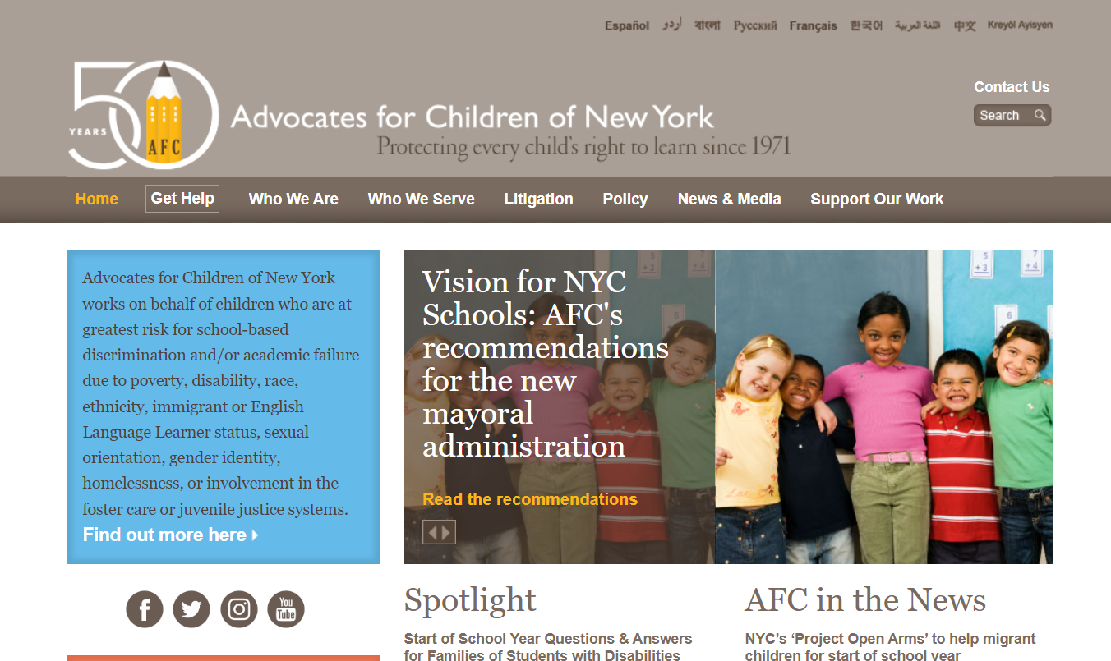
Check For Updates On Our Website
4
Notes:
When we send you the PP, the links should work. If not, you can always call our helpline

Slide 5
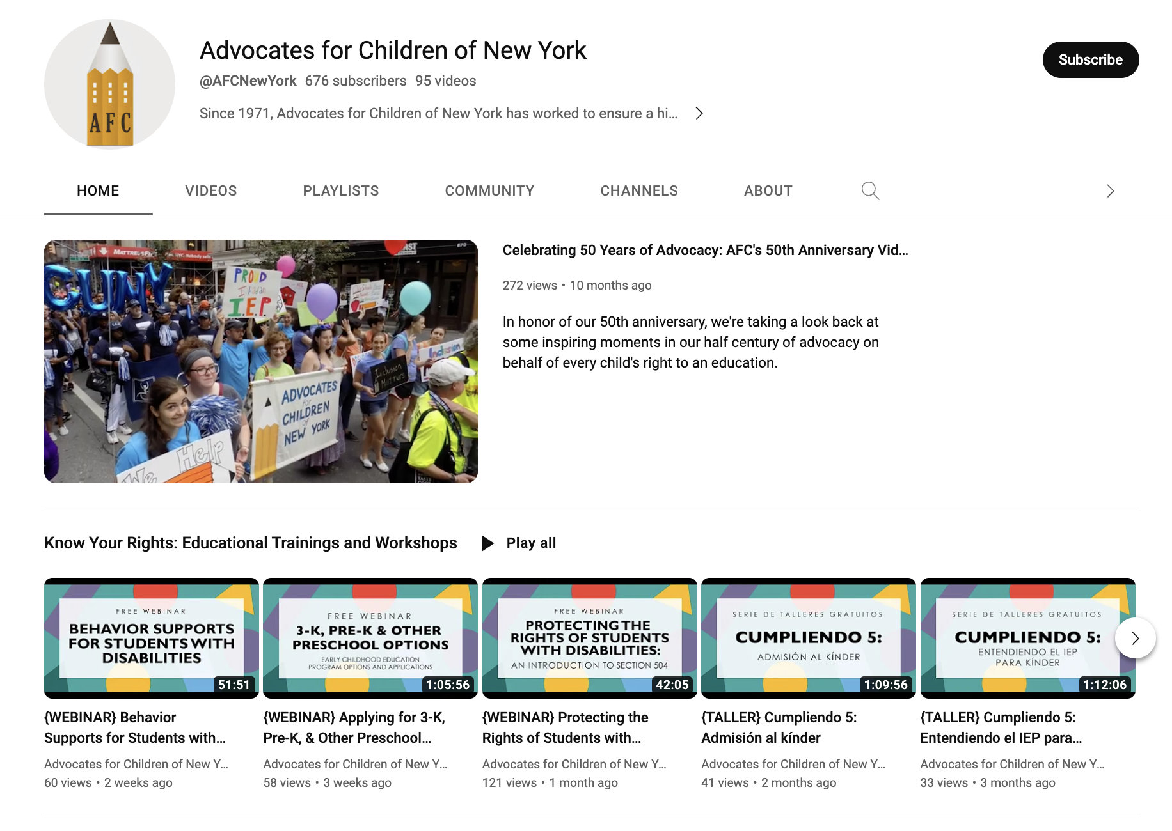
Check Out Our Webinars on YouTube
Notes:
LDP

Slide 6
Main legal concepts for IEPs
Notes:
There are two federal laws that provide rights to children with disabilities in school: s. 504 of the Rehabilitation Act and the Individuals with Disabilities Education Act (IDEA). Today, in the interest of time, I am going to focus on the IDEA, but you should be aware that section 504 also provides accommodations for students and parents with disabilities.

Slide 7
The IEP is:
Individualized – based on student needs
Legally binding (like a contract)
Good for one year
Created at meeting - Parent is team member
Must get a copy of IEP
Notes:
Individualized Education Program
Based on Fed + State Law
Based on what student needs, not what school has – each student’s should look different
Must review at least once a year, but you can always request to have an IEP meeting!

Slide 8
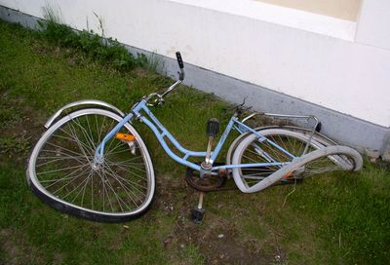
Free Appropriate Public Education (FAPE)
FAPE = programs and services designed for the student’s unique needs
Must provide a meaningful benefit
Helps the student progress
“A Chevy, not a Cadillac”
Notes:
Endrew F. v. Douglas County Sch. Dist. RE-1, 137 S. Ct. 988, 1000 (2017). “Special education” is “specially designed instruction” that adapts, as appropriate to the child’s needs, “the content, methodology, or delivery of instruction …to ensure access of the child to the general curriculum, so that the child can meet the educational standards within the jurisdiction . . . that apply to all children.”
The definition of “appropriate” comes from a Supreme Court case, Board of Education of the Hendrick Hudson Central School District, Westchester County v. Rowley, 458 U.S. 176 (1982).

Slide 9
Least Restrictive Environment (LRE)
Goal is inclusion
As much as possible, students with disabilities learn with students who do not have disabilities
Notes:
Students attend special education classes or schools only when their disability requires it

Slide 10
LRE
D1-32
Small Class
D75
Private
ICT
Gen Ed with SETSS/RS
Small Class
NPS
Residential
Inclusion
Continuum of services and placements based on:
Student’s needs
Evaluation results
Input from IEP team members including the parent
Notes:
FRom the least restrictive to the most restrictive

Slide 11
Sections of IEP (Part I)
Student Needs
Present Levels/Needs
Goals & Reporting
School will provide
Compensatory Services
Testing Accommodations
Transition
Name, Classification,
Programs/Services
Implementation Date
IEP Review Dates
Notes:
Compensatry services

Slide 12
Sections of IEP (Part II)
Testing, Inclusion, Busing
State testing
Inclusion with students without disabilities
Transportation
Other
Placement type
Instructional levels
Summary
Promotion Criteria
Other options considered
Meeting Attendance
Accessibility

Slide 13
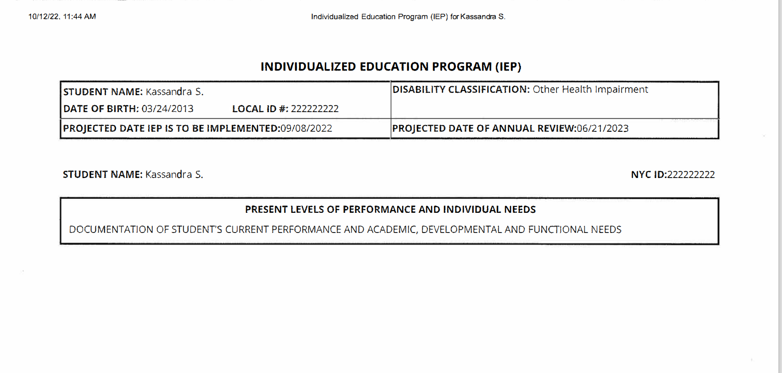
First Section of IEP
Classification
Implementation Date
Annual Review Date
“PLOP” Present levels
Notes:
The entitlement to appropriate services:
services that provide meaningful educational
benefit and enable the student to make progress—for a student with disabilities.
Not “good” services, or “bad” services.
“Appropriate” services that address a student’s unique needs.
It is a CHEVY and not a CADILLAC

Slide 14
Classifications
Classifications of disability…
Autism Deafness Deaf-Blindness Emotional Disturbance Hearing Impairment Learning Disability Intellectual Disability | Multiple Disabilities Orthopedic Impairment Other Health Impairment Speech or Language Imp. Traumatic Brain Injury Visual Impairment
Children ages 3-5 will be classified as a
“preschool student with a disability.”
Notes:
Only 13 possible classifications
Disability must “adversely affect a child’s educational performance”

Slide 15
Present Levels of Performance (PLOP)
Should include CURRENT standardized scores
Academic, Social, Physical, sections
Parent concerns (use this section!)
Management Needs, Inclusion
Notes:
Bolded subheading for each.-- usually the longest section

Slide 16
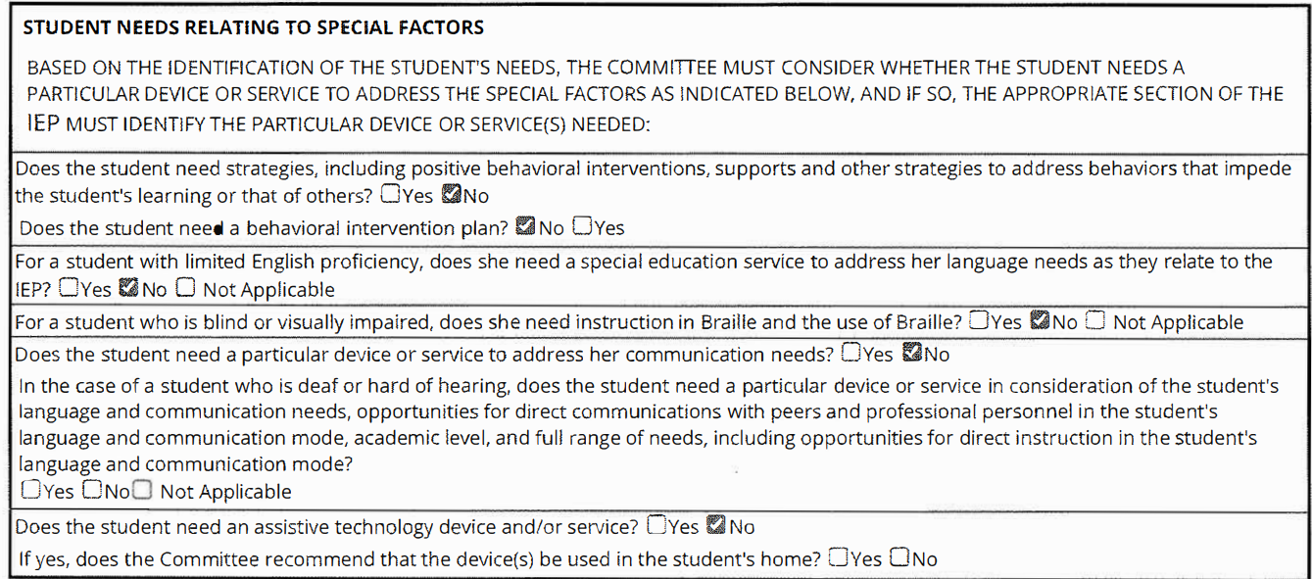
Student Needs and “Special Factors”
Behavior Plan
Language Needs
Assistive Technology
Visual Needs
Communication Needs/Deaf or Hard of Hearing

Slide 17
Measurable Postsecondary Goals
Should match Transition plan
Ask about diplomas here
Summary of plans and needs
Notes:
IEP does not have a dedicated diploma option section

Slide 18
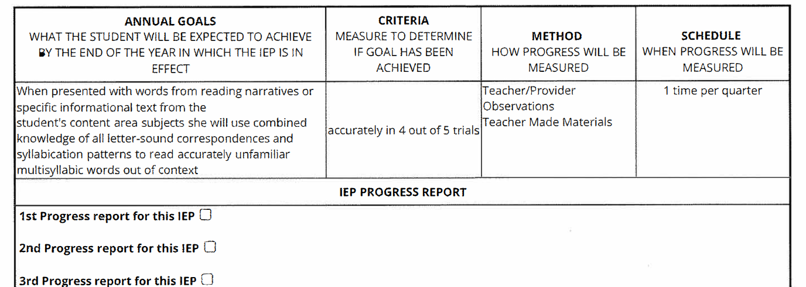
Annual Goals
Should be measurable
What will be measured, how, how often...
Progress reports-request as needed!
A goal per each need!
Notes:
Benchmarks—another section for preschool aged students and also for students who are not subject to the Standard NY Promo Criteria— alternate assessment. The benchmarks are short term goals, which must be reviewed within a shorter time frame.
Some students who are subject to the Promo criteria have modified criteria
Most students have annual goals that are reviewed at the next IEP meeting (can request IEP meeting—do not need to wait)--but also remember progress reports have to be provided as spelled out in the IEP

Slide 19
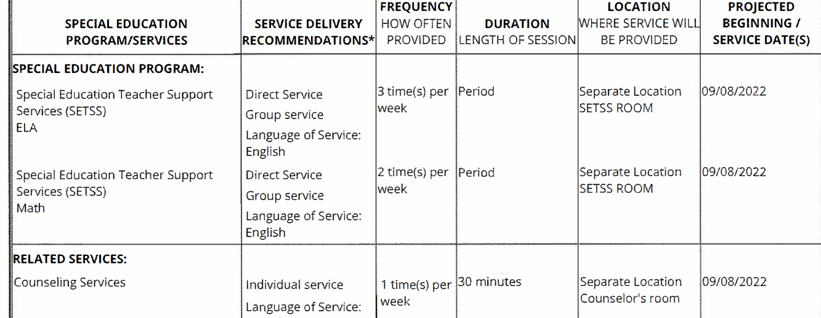
Recommended Special Ed Programs/Services
Type of classroom setting
Related Services (ratio)
Note how often, how long, and where
Start date of services!
Notes:
Type of classroom, not placement recommendation

Slide 20
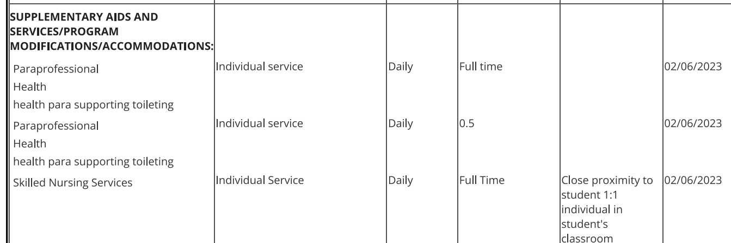
Supplementary Aids / Modifications / Accommodations
1:1 Paras, Nurses
Support specific needs-toileting, health...
Note the duration and ratio!
Notes:
Start date, again

Slide 21
Assistive Tech/Supports for School Staff
AT Devices AND services
Note location of service!
Can include staff training!
Notes:
AT is---devices tools...
Services to program device—software updates,

Slide 22
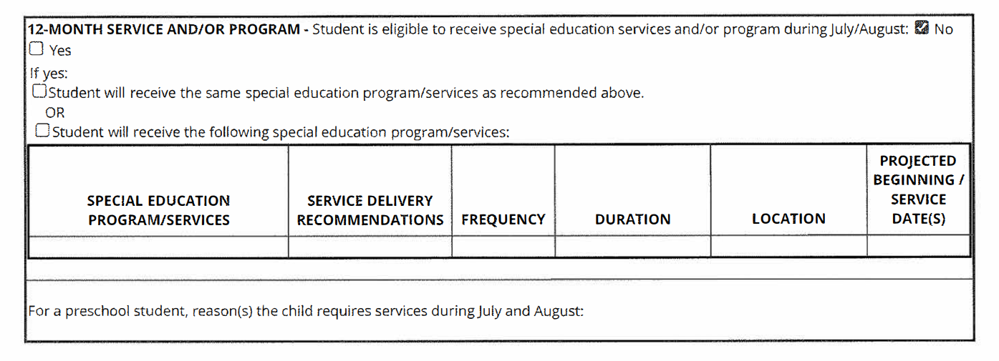
Extended School Year Program/Service (12 month)
ESY is not summer school: specialized services
Can get same or different services than school year
Combine with Summer Rising/Summer School
Only if needed to prevent regression
Notes:
Regression, continued services and support
Can get ESY D1-32—not just for D-75
Summer Rising: can have an academic component (special ed) with the enrichment and fun part later

Slide 23
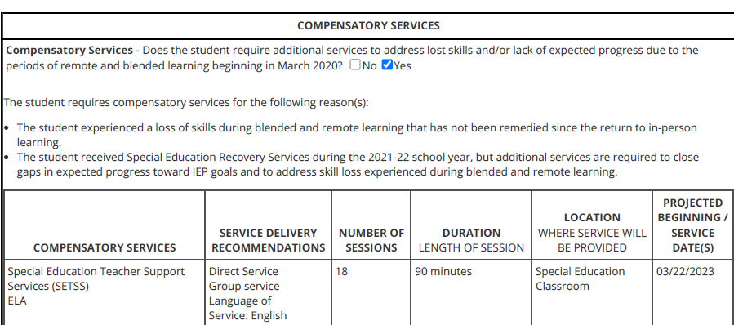
Compensatory services
New! For COVID era learning loss
Services in addition to regular IEP services
Supposed to discuss at IEP, if not ASK!
Notes:
Comp services: generally
COVID comp Services for COVID era learning loss (to make up for lost or inappropriate instruction)

Slide 24
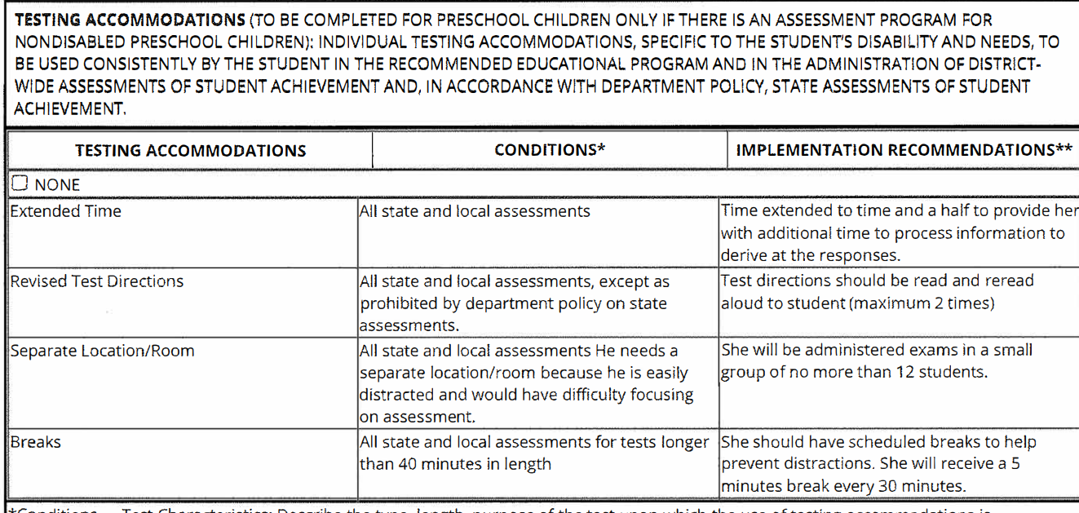
Testing Accommodations
Testing conditions not modifications
Note what kinds of testing this applies to (State, Class...)
Often = extra time, calculator, separate location and breaks.
Notes:
These are not testing modifications
Scribes, Qs read out loud, Text read out loud

Slide 25
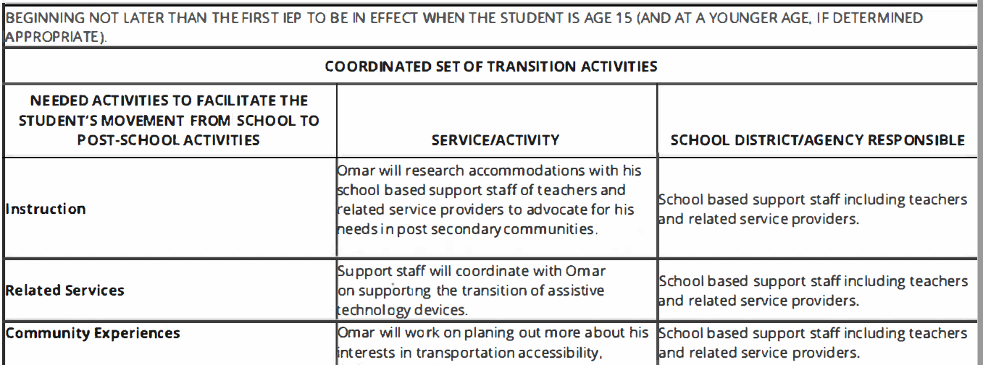
Transition Activities
Notes:
Transition is....
Transitioning to Kim!

Slide 26
Participation in State Assessments
Most students participate
Alternate assessment for students with “severe cognitive disabilities”
Also see modified promotion
http://www.nysed.gov/state-assessment/new-york-state-alternate-assessment
Notes:
Modified promotion = when a student who is subject to the standard criteria for promotion, gets an individualized criteria instead.
For example: 3rd grader promo criteria is modified to say "meets 2nd grade criteria." Less common now, affected by policy changes

Slide 27
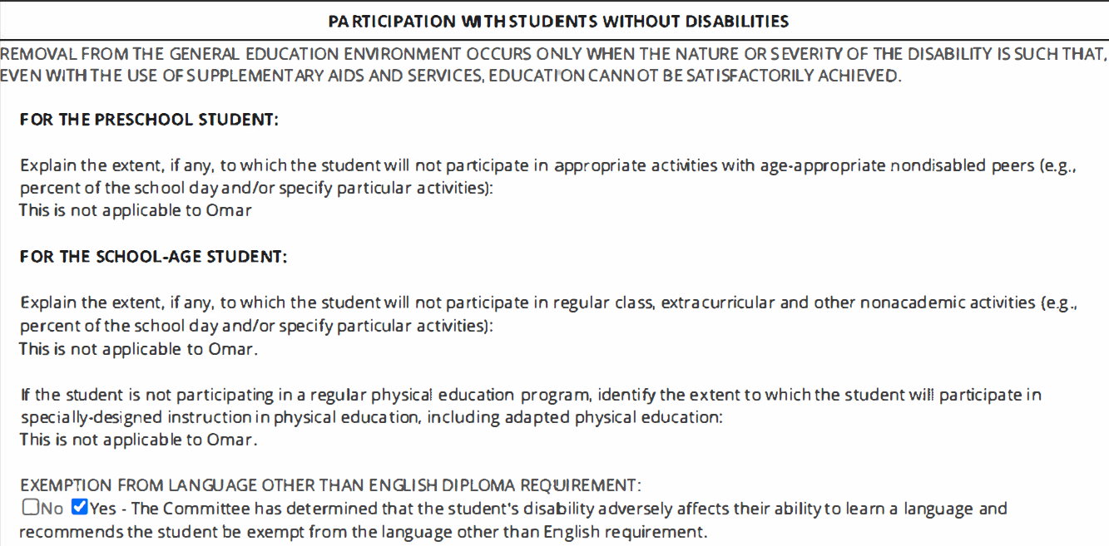
Participation with students without disabilities
Trips
Adaptive PE
2nd Language
Notes:
Justification for removal from general education into a more restrictive setting
Look here for trip modifications (cannot go on a trip or needs mods to participate), APE and to graduate HS without the language requirement

Slide 28
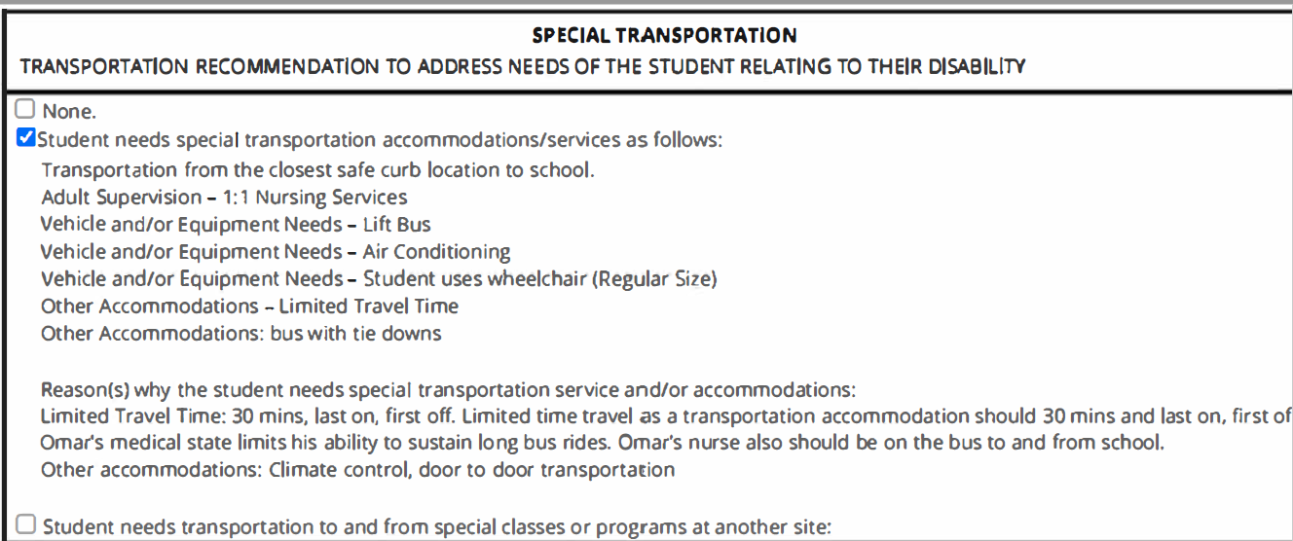
Transportation Accommodations
Compare to MyStudent
Doctor’s letter – be specific about why
Double check with bus company
Problems? Call school and OPT. Get complaint #

Slide 29
Placement Recommendation
District 1- 32: Gen Ed, ICT, Small Class (12:1/15:1 or 12:1:1)
District 75: Small Class (6:1:1, 8:1:1, 12:1:1, 12:1:4)
Non-Public School (day, residential)

Slide 30
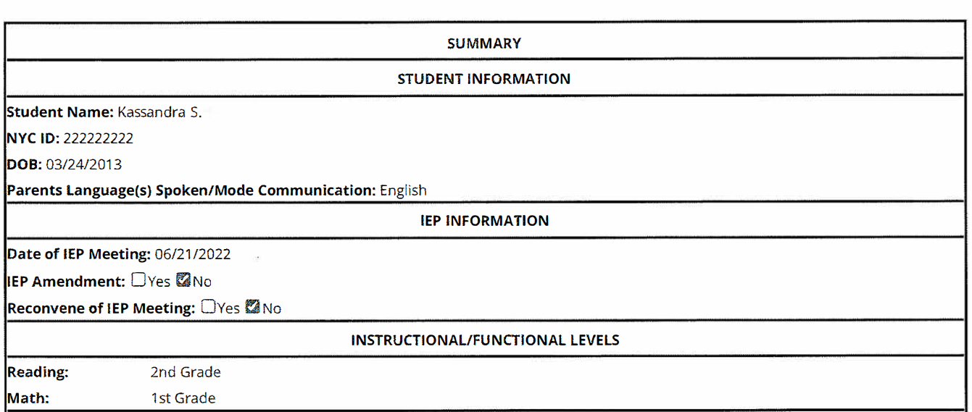
City Summary Pages
Parent Language
Date of meeting
Change?
Levels
Notes:
NYC Exclusive
Levels are ballpark-look at PLOP for better and more detailed information.

Slide 31
City Summary Pages (2)

Slide 32
City Summary Pages (3)
Only section with medical alerts and accessibility needs

Slide 33
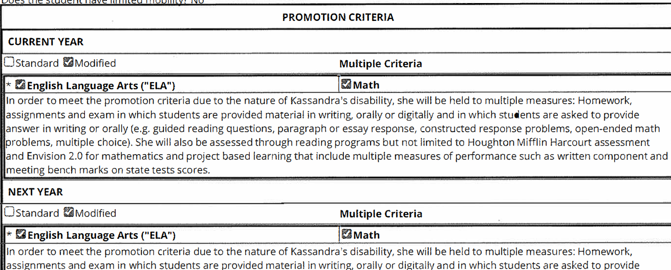
Promotion Criteria
Should explain why modified
Less common since promotion not based on state tests
Ask for more support if not meeting standard promotion criteria

Slide 34
Other options considered
If you ask for a program, should show up here.
Sometimes schools explain what they don’t have (“Considered small class but don’t have”)
Important section but not always accurate (didn’t consider)
Notes:
If you are happy with the program, this does not matter much,
But if not-this is important and should reflect what actually was discussed

Slide 35
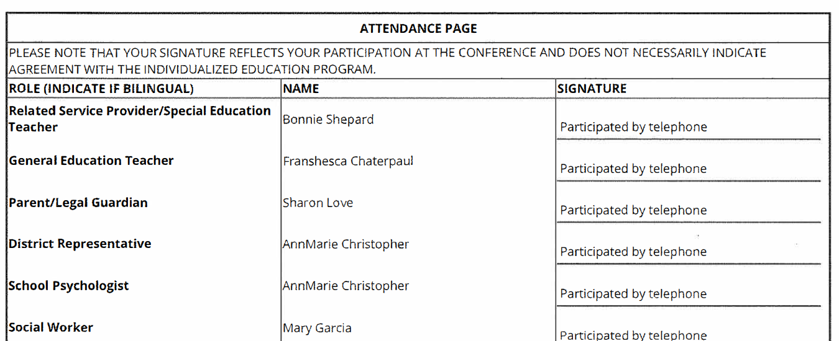
Attendance
Certain team members required.
Pro tip: Sign, date and take a photo of this page
One person can fill two roles (i.e. Dist. Rep and Psychologist)

Slide 36
What is NOT on the IEP?

Slide 37
IEPs

Slide 38
The IEP Meeting
Who is at the meeting?
Parent(s)
Special
Education
Teacher
General Education Teacher
If the student is or may be in general ed classes
Have right to 7 days notice
Other Persons
Student
School Psychologist
District Representative
Including interpreters
Explains evaluations or change in setting
As appropriate (15 or older)
Knows district services
Notes:
38
Parents have the right to attend IEP meetings! They should be given notice of the meeting at least 7 calendar days in advance. If you cannot attend the meeting, you have the right to reschedule. Your attendance is crucial.
At the IEP meeting, the team will:
Consider the results of evaluations, including any independent evaluations
Consider the strengths and needs of the student and his/her present levels of performance
Determine if the child is eligible for special education services
Decide what services and accommodations the child needs based on his or her disability
District Representative – representative of the district who is qualified to provide or supervise special ed and who is knowledgeable about the general ed curriculum and the resources available (this role may be filled by the special education teacher or the psychologist)
Students must be invited to participate in IEP meetings where transition planning is or should be discussed. Transition planning must begin starting with the IEP that will be in effect when the student is 15.

Slide 39
Tips for IEP Meetings
Ask for any reports or evaluations before the meeting
Sign and get a copy of the attendance sheet
Get a draft of the IEP after the meeting
Get the finalized IEP. Compare it to your notes!
Notes:
IEP Worksheet—helpful to plan and track IEP meeting progress.
Except for preschool aged students, schools rarely share evaluations, reports, or draft goals before meetings. Ask for the documents! Parents have the right to reports. Reports should be sent before the IEP meeting by mailing them at least 7 calendar days before the meeting. They are rarely ready by then, but you can and should get them ahead of time. Read them, take notes, and write down questions or ideas you may have ahead of time.
Signing the attendance form does not indicate agreement with recommendations, it just means that you were preset. The attendance page should reflect “TO” or by telephone for those participating by phone. Parents can participate by phone if they choose. So can others (i.e., outside therapist, tutor, etc.)
If schools won’t give you a draft IEP, take a picture. Even if nothing is printed out, you can usually see something on the computer screen.
Notes – bring binder, folder with your child’s documents, tabs; special education guide, due process rights; you are a professional parent; can step out, take a break.

Slide 40
How to sort through papers:
40
What are your child’s needs?
Are evaluations correct?
If not, get new evals.
What should IEP say?
Describe needs accurately?
Is your child getting what’s on IEP?
If not, why not?
Recommends right program?
Is Program working?
Does staff have the right skills/training?
Other supports needed?
New school? Extra services?
Notes:
IEE and AA
IEP can be wrong because careless, don’t know full range of programs, or offer only what they have.
Can not provide because don’t have it or don’t know about it

Slide 41
Language Access Rights
41
Parents have the right to get documents translated, including report cards and IEPs
Parents also have the right to interpretation services at school meetings and events
DOE Languages: Spanish, French, Arabic, Chinese, Bengali, Urdu, Russian, Korean, and Haitian-Creole
Problems with translation or interpretation?
Email Hello@schools.nyc.gov or
Call DOE complaint line: (718) 935-2013
Chancellor’s Regulation A-663
Notes:
LDP
All public school parents whose primary language is not English have a right to translation and interpretation. A student does not need to be identified as an English Language Learner (ELL) for the parent to request translation or interpretation.
Under federal, state, and local laws, parents have the right to translation of all school-related documents. This includes documents that go out to everyone (like a flyer about the high school admissions process) and student specific documents, like report cards and IEPs.
Parents also have the right to interpretation services at school-related meetings, including parent-teacher conferences
Should not be told to bring your own translator or that their child should translate
Interpreters should be impartial/neutral. DOE has access to a language line (phone conference) if no in-person translator available.
DOE Covered languages: DOE must have document available in this language; may use other means to translate documents into other languages.

Slide 42
Questions?

Slide 43
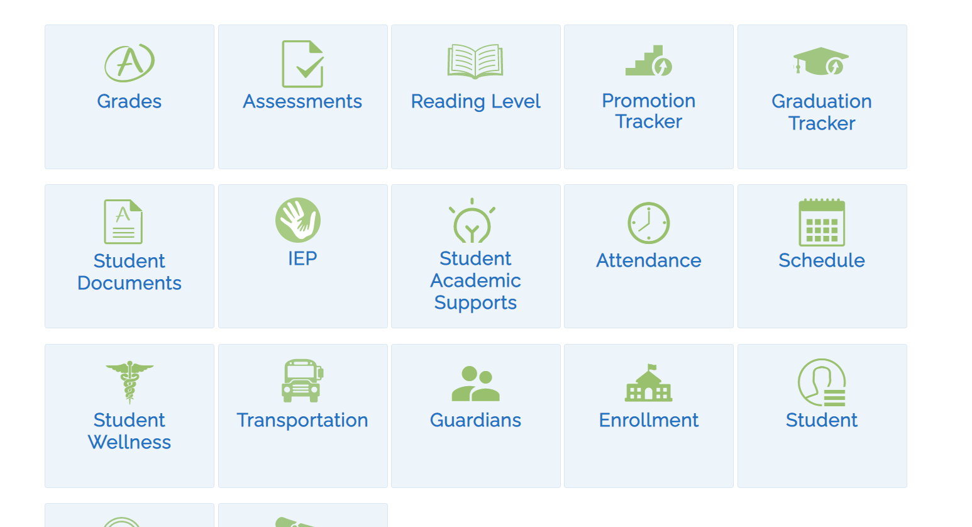
My Student Portal “NYCSA”
43
Need an account? Ask your child’s school
Notes:
First, I want to tell you about where you can find some information latest assessments, IEP, students supports.
Don’t quite know what your child is receiving when last evals were? Check My student.
Don’t have an account? Ask parent coordinator/school administrator
https://www.schools.nyc.gov/learning/student-journey/nyc-schools-account

Slide 44
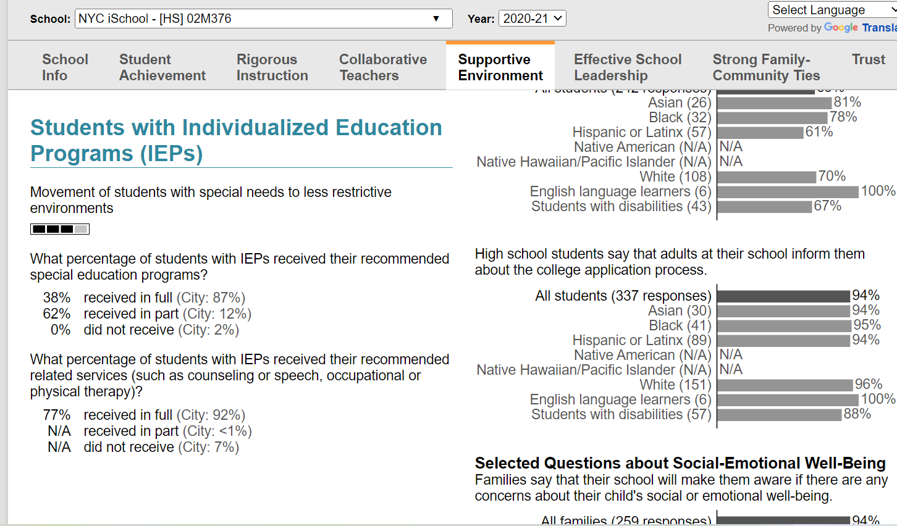
Are students getting what is on their IEPs?
Find school on DOE website, look for School Quality Reports, under Supportive Environment
Notes:
How to use their systems to find stuff

Slide 45
How do I know if a school has a small class or ICT?
Look up school on DOE website
Go to “School Quality” Reports
Click on “School Quality Guide” 2nd in list NOT Snapshot
Click on “+” next to SWD

Slide 46
NYC School Level Class Size Report
https://infohub.nyced.org/reports/government-reports/class-size-reports Click on “Detailed School Level Data” Excel file

Slide 47
What if You Disagree with the DOE?

Slide 48
Informal Dispute Resolution
Start with the School
Parent Coordinator, Principal
District Superintendent’s Office
Family Support Coordinator or District Family Advocate
DOE Central – Office of Special Education
(718) 935-2007 or specialeducation@schools.nyc.gov
For school and superintendent contact: https://sites.google.com/schools.nyc.gov/edudirectory/home

Slide 49
Formal Dispute Resolution
Mediation
Impartial Hearing
Voluntary meeting.
Parent and DOE discuss the problem.
A mediator facilitates.
Parties control the outcome
Parties may still go to an Impartial Hearing
Is a legal proceeding.
An Impartial Hearing Officer (IHO) in charge.
Written decision based on:
Witnesses
Documents
Can appeal decision
Notes:
Due process is a set of specific procedures for resolving disagreements with any of the school’s processes or decisions regarding the child’s identification, evaluation, educational placement or provision of FAPE.
Notice of your Rights
¡IDEA: Procedural Safeguards Notice
¡Section 504: notification of protections and how to access them
Right to Get Written Notice before the DOE Proposes to Change your Child’s Placement, IEP, or Classification (IDEA only)
Pendency: Right to Keep Your Child in the Current Placement after you file for mediation or an impartial hearing. (IDEA only)
Right to Appeal if you disagree (both)

Slide 50
Let’s Review!
The IEP is a legal document containing mandated services needed for your child to make educational progress.
The parent is a key member of the IEP Team!
Your knowledge of your child, your input, concerns and requests should be respected, considered and reflected on the IEP.
Learn more about your child’s disability—and share with them what you know!
Remember: You are your child’s best advocate.
Don’t be afraid to ask questions!

Slide 51
Upcoming Webinars...
Tuesday, April 11 · 4 - 5pm
Thursday, April 27 · 10 - 11am

Slide 52
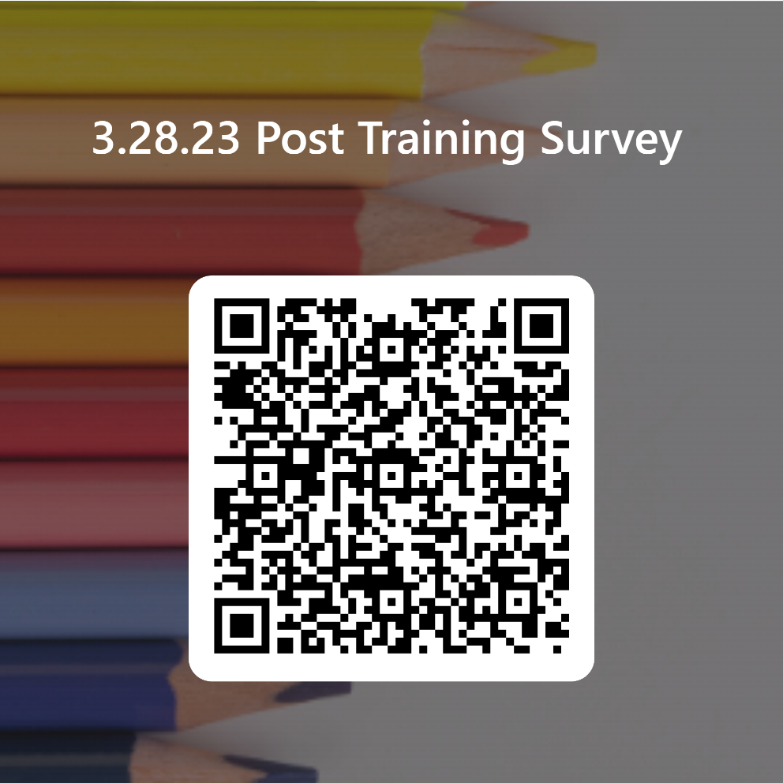
Please take our survey!
https://bit.ly/understandingtheiep

Slide 53
Call us with questions!
Helpline: 866-427-6033 (toll free)
Monday-Thursday, 10am-4pm
info@advocatesforchildren.org
Notes:
Thank you for coming! Please complete our evaluation before you go.
Remind audience that this process is complicated, with lots of information, won’t be able to answer all questions…
So they should call us with questions!!
Use our guides!
Go to more workshops!

